Slide 1
02/04/2021

Slide 2
C1 vs C2

Slide 3
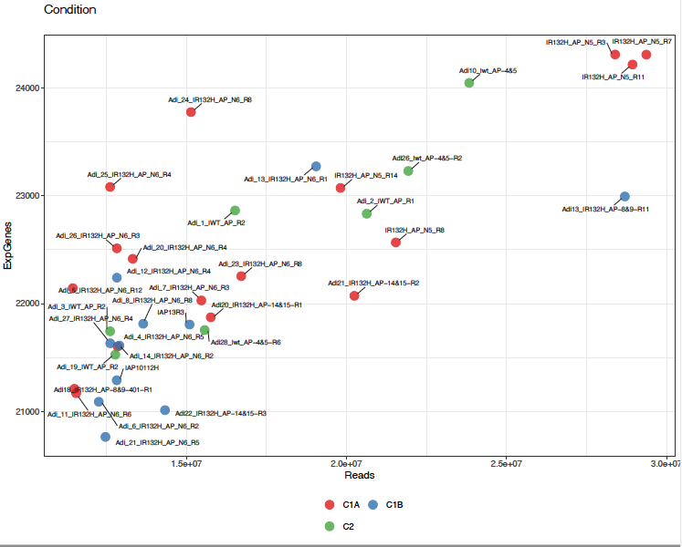
Principal component analysis C1 vs C2

Slide 4
Number of genes DEGs between C1 and C2
Analysis November 11/11/2020
qval lfc | 0.05 1 | 0.05 2 | 0.05 3 | 0.01 1 | 0.01 2 | 0.01 3 | 0.001 1 | 0.001 2 | 0.001 3 | 1e-04 1 | 1e-04 2 | 1e-04 3
DESeq2_rmv5_Adi18_10_22_CSHS15 | 5594 | 1801 | 310 | 5100 | 1668 | 260 | 4506 | 1481 | 206 | 3967 | 1306 | 151
Analysis February 02/04/2021
qval lfc | 0.05 1 | 0.05 2 | 0.05 3 | 0.01 1 | 0.01 2 | 0.01 3 | 0.001 1 | 0.001 2 | 0.001 3 | 1e-04 1 | 1e-04 2 | 1e-04 3
adi_february_2021 | 5552 | 972 | 50 | 4898 | 972 | 50 | 4011 | 972 | 50 | 3223 | 860 | 50
q.value 0.05 and lfc 1
q.value 0.01 and lfc 2
(Ceccarelli size = 2274)
(Ceccarelli size = 2274)
19%
2 %

Slide 5
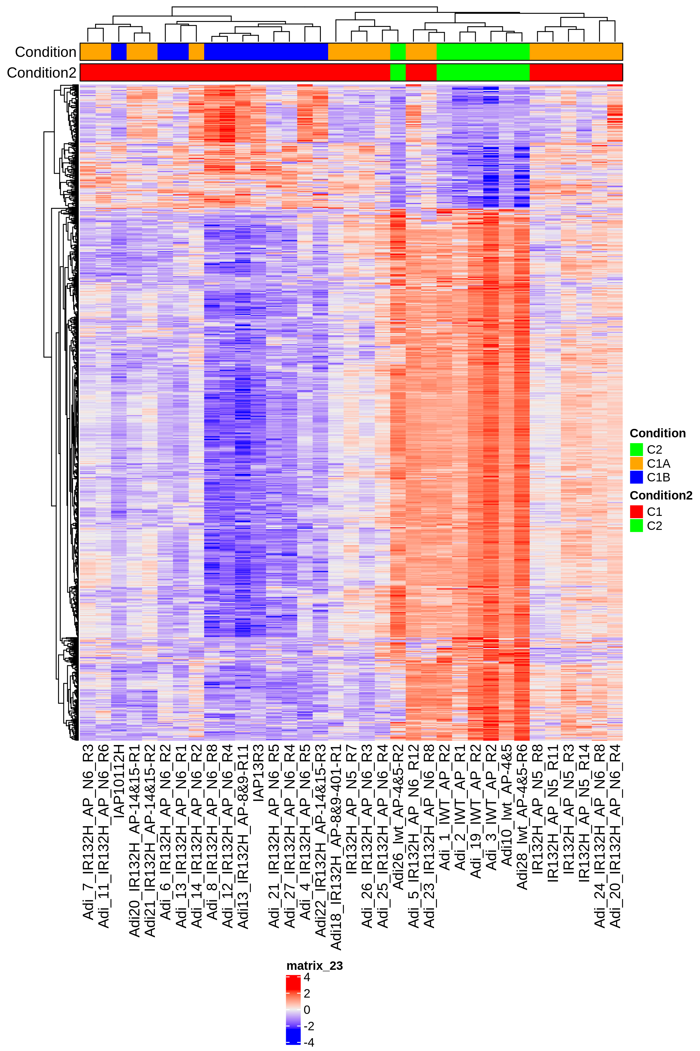
Differentially express genes between C1 vs C2 (q.value 0.01 – 2)
n. genes= 972

Slide 6
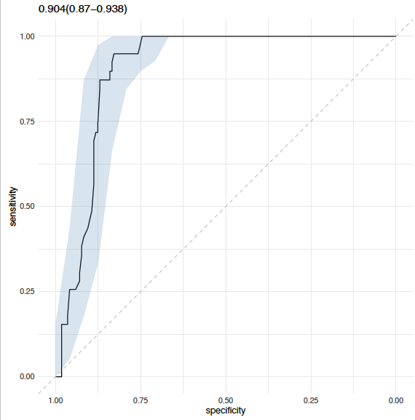
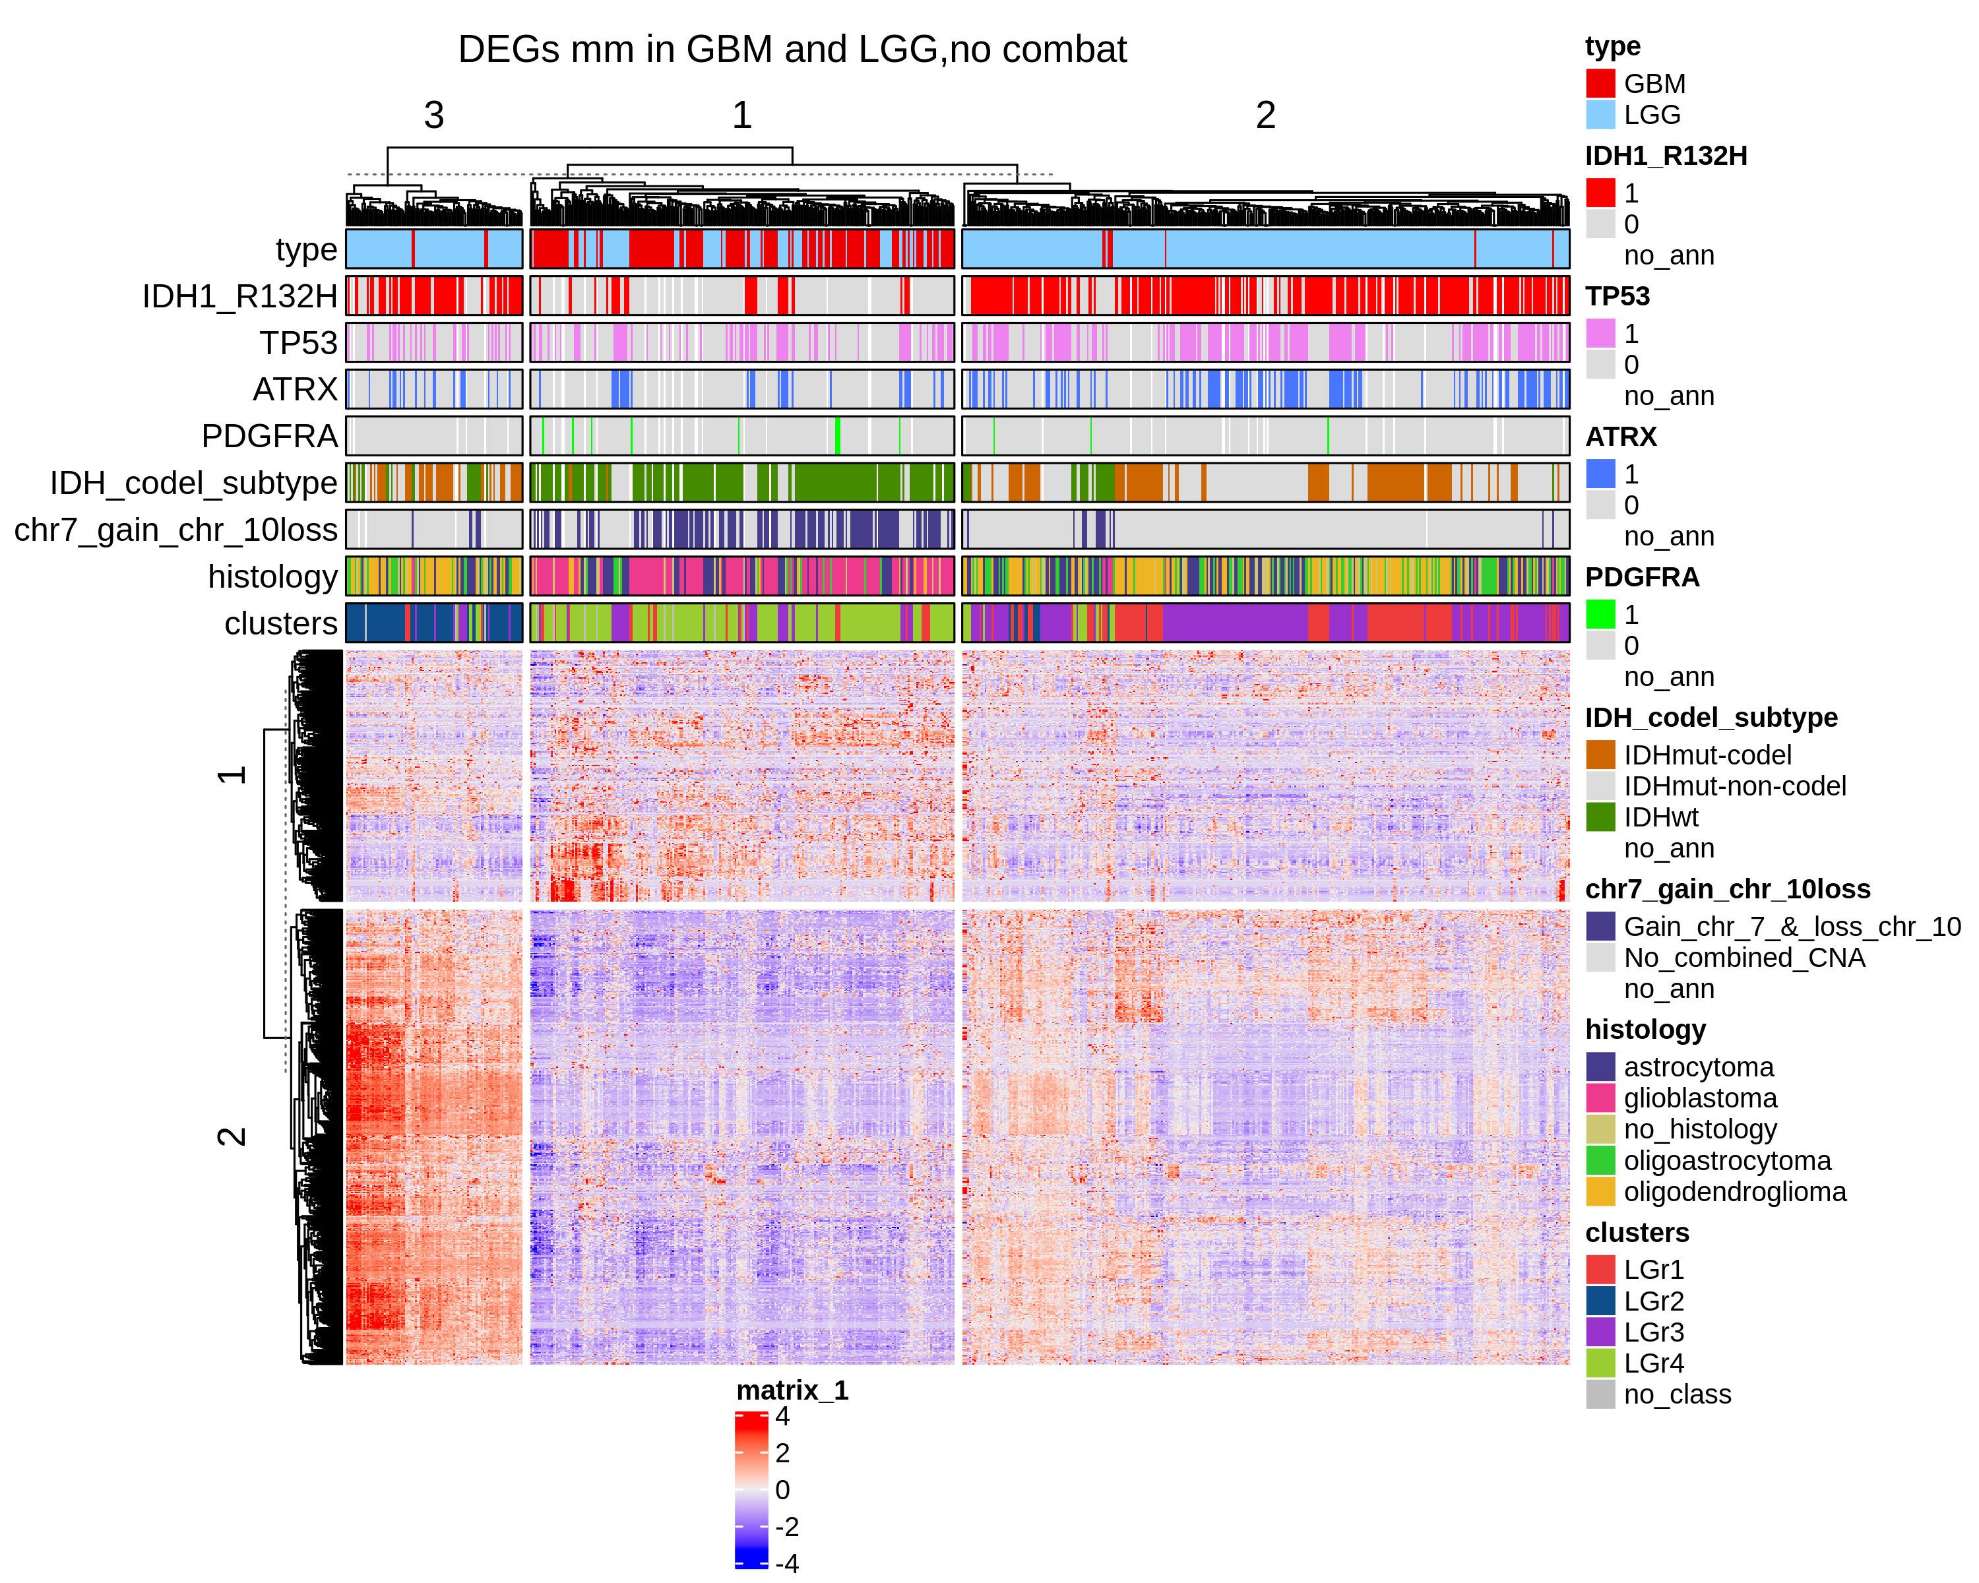
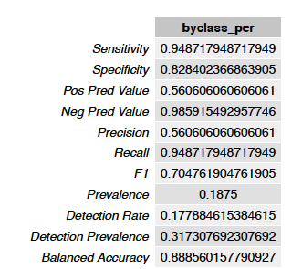
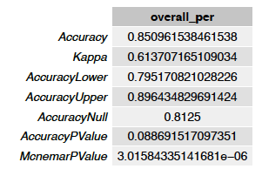
Differentially express genes between C1 vs C2 (q.value 0.01 – 2)
GBM + LGG
n.genes= 797

Slide 7
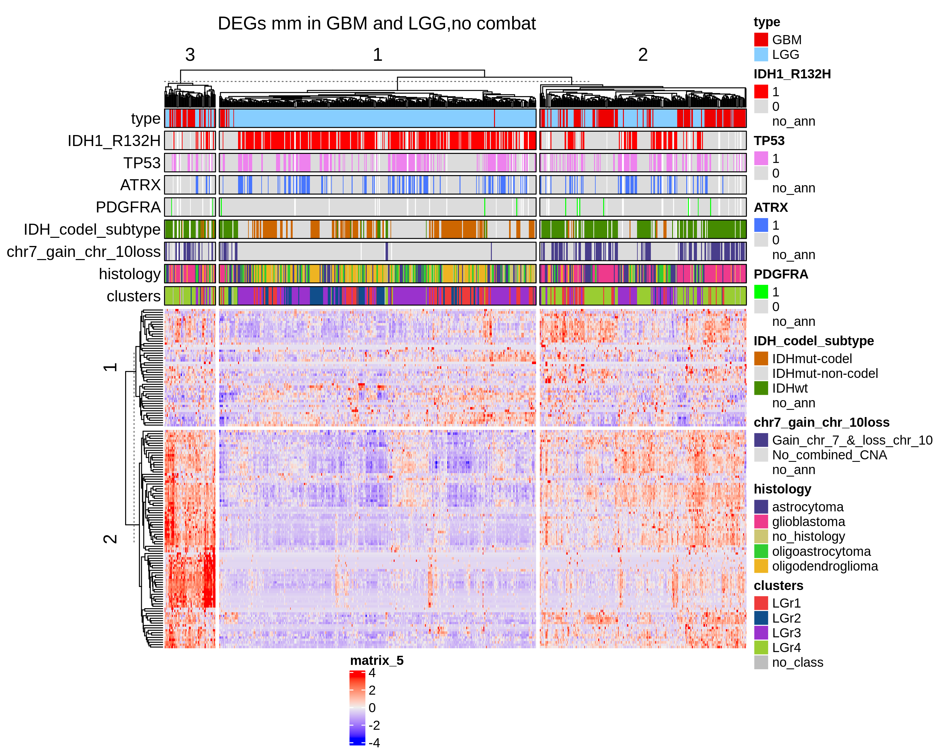
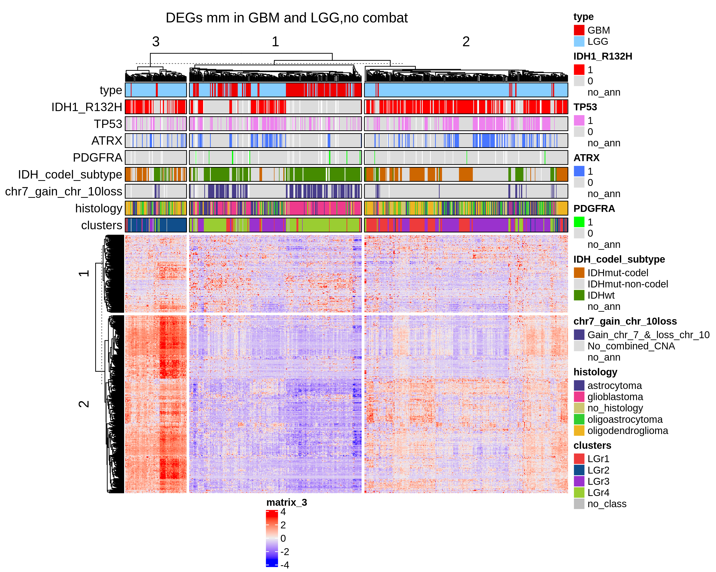
Differentially express genes between C1 vs C2 (q.value 0.01 – 2)
GBM + LGG
UP regulated genes
Down regulated genes

Slide 8
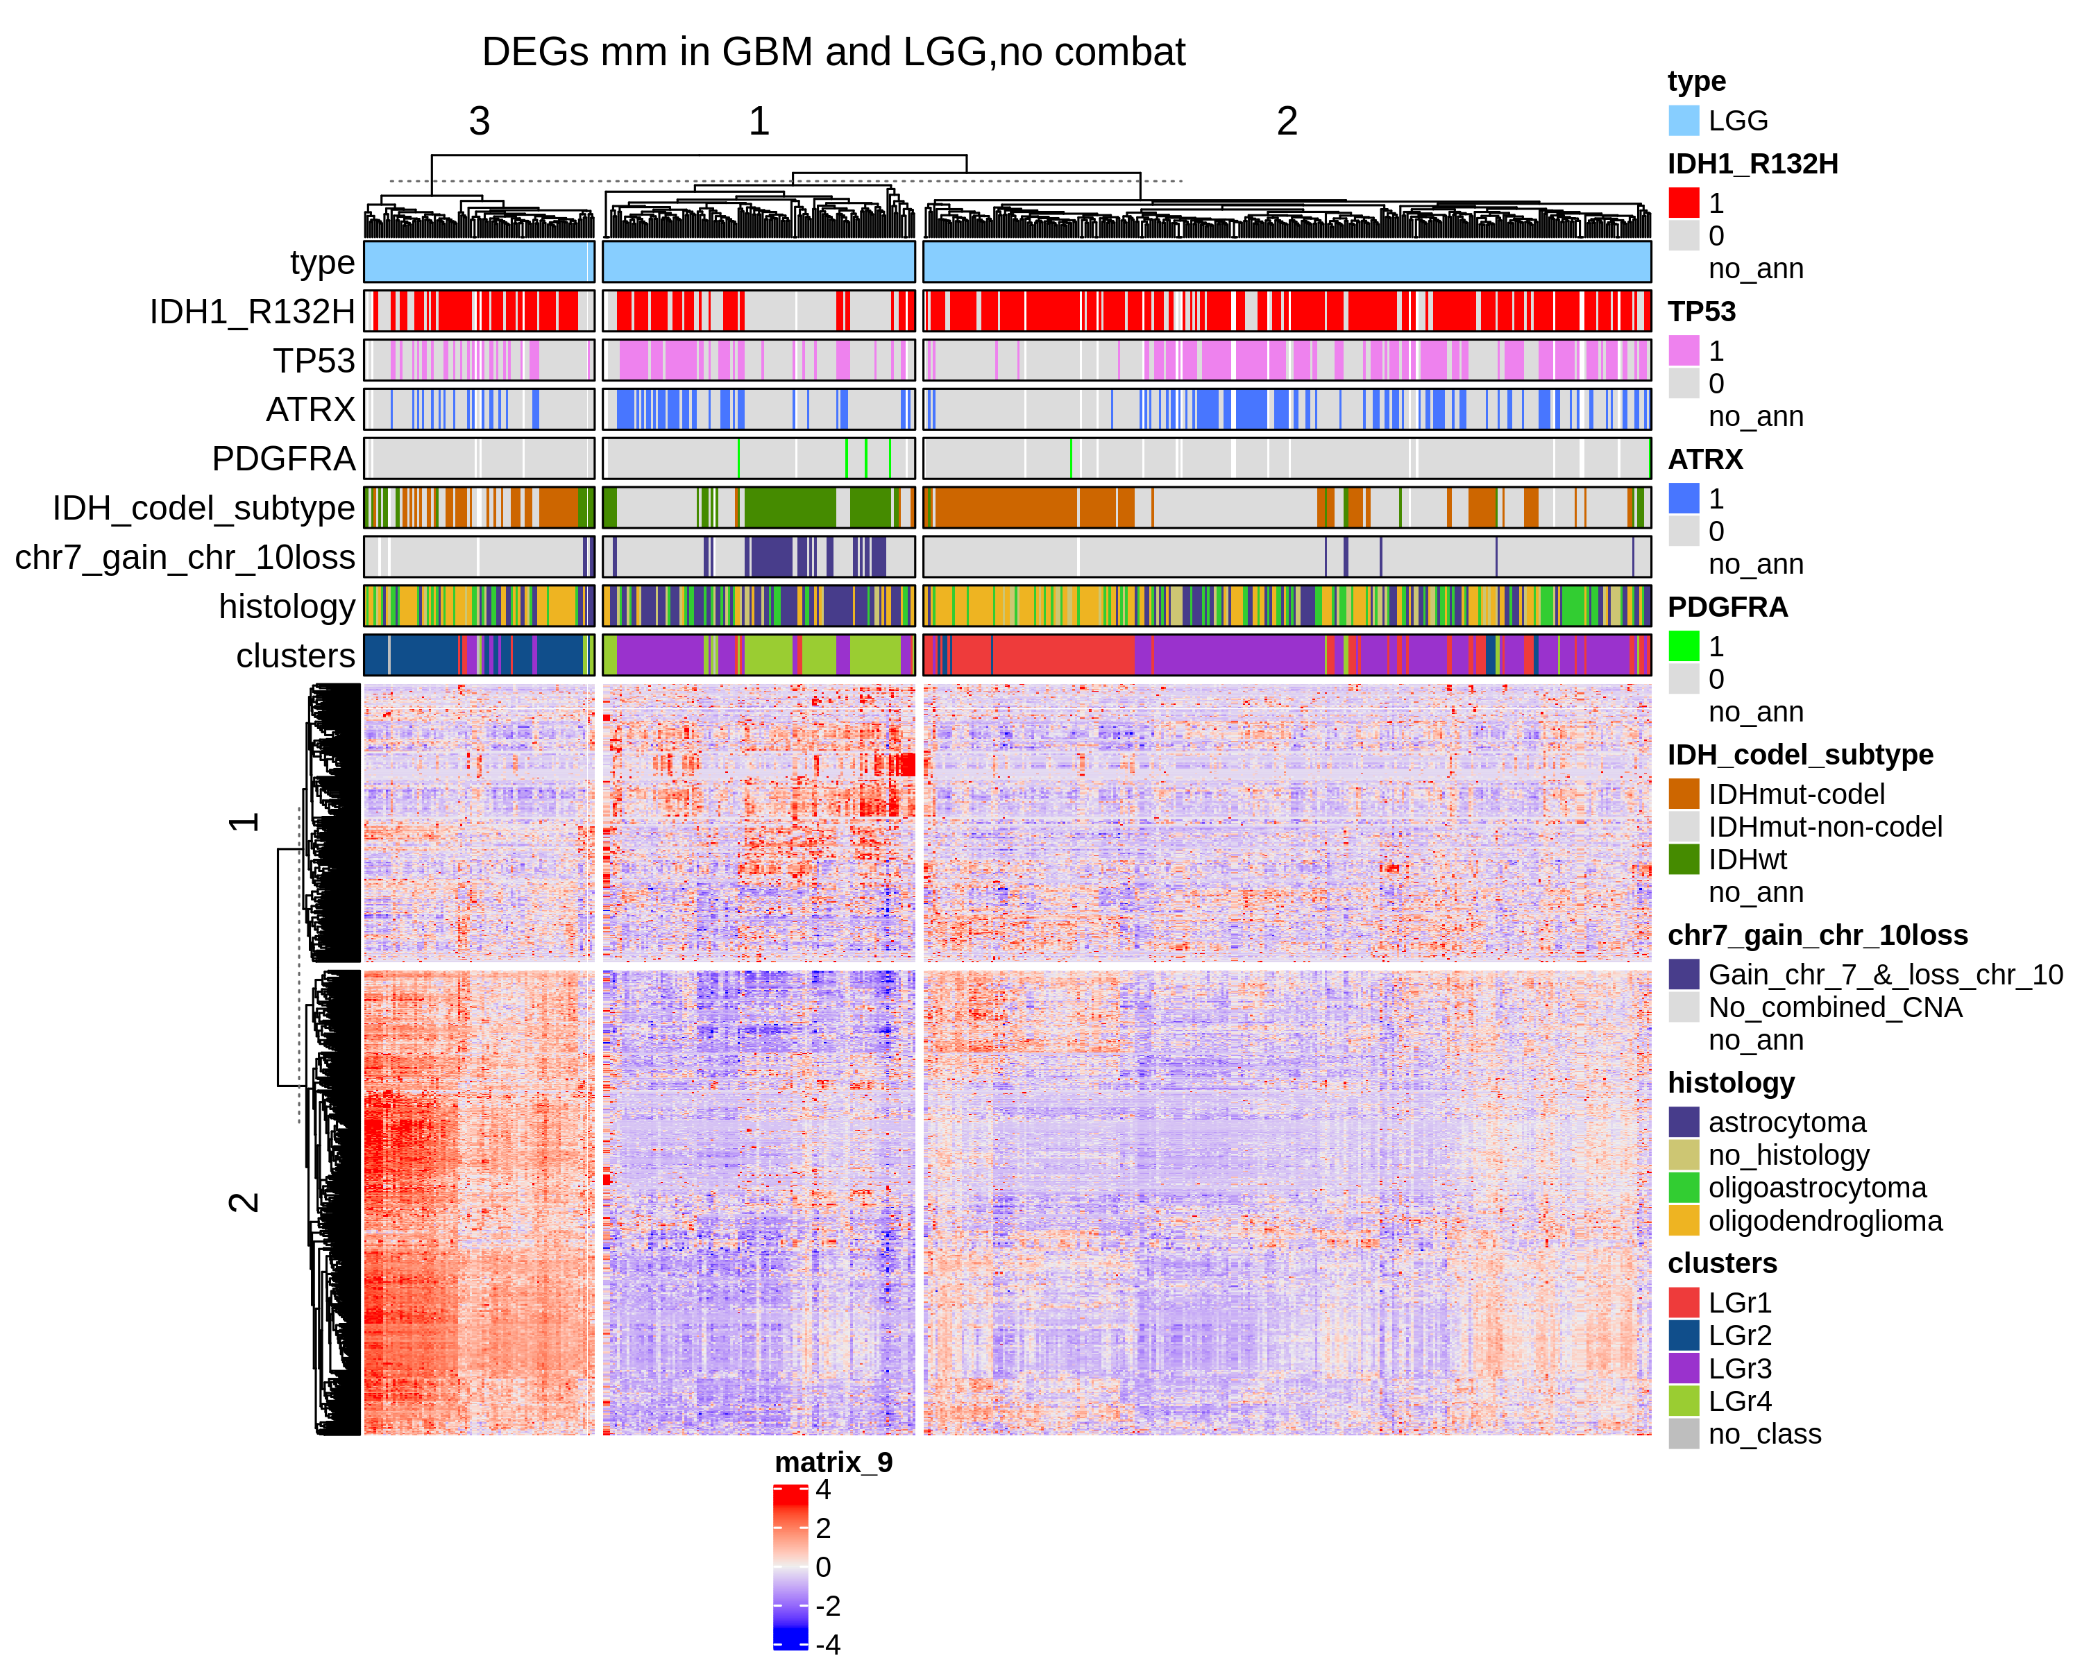
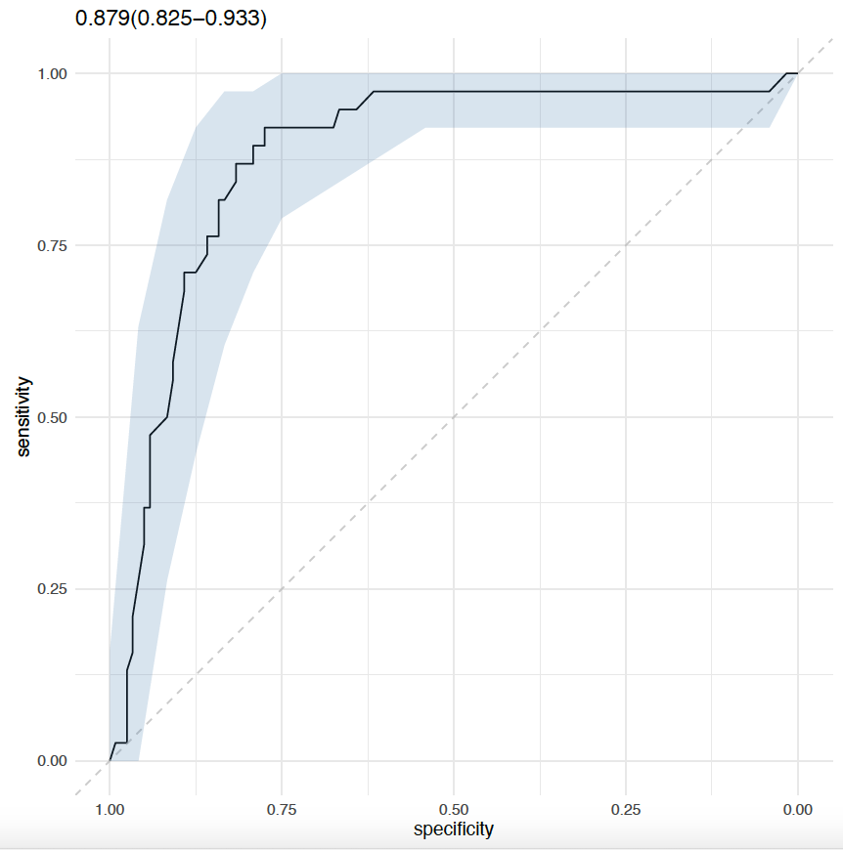
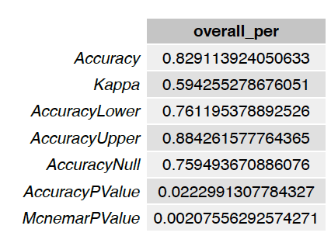
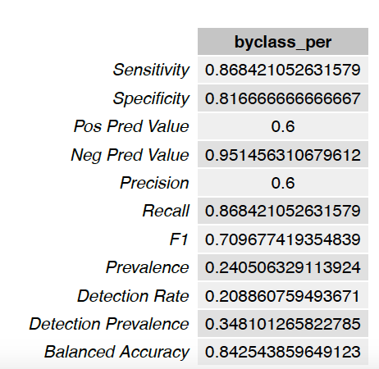
Differentially express genes between C1 vs C2 (q.value 0.01 – 2)
LGG
Show only the samples with TRIPLE mutations

Slide 9
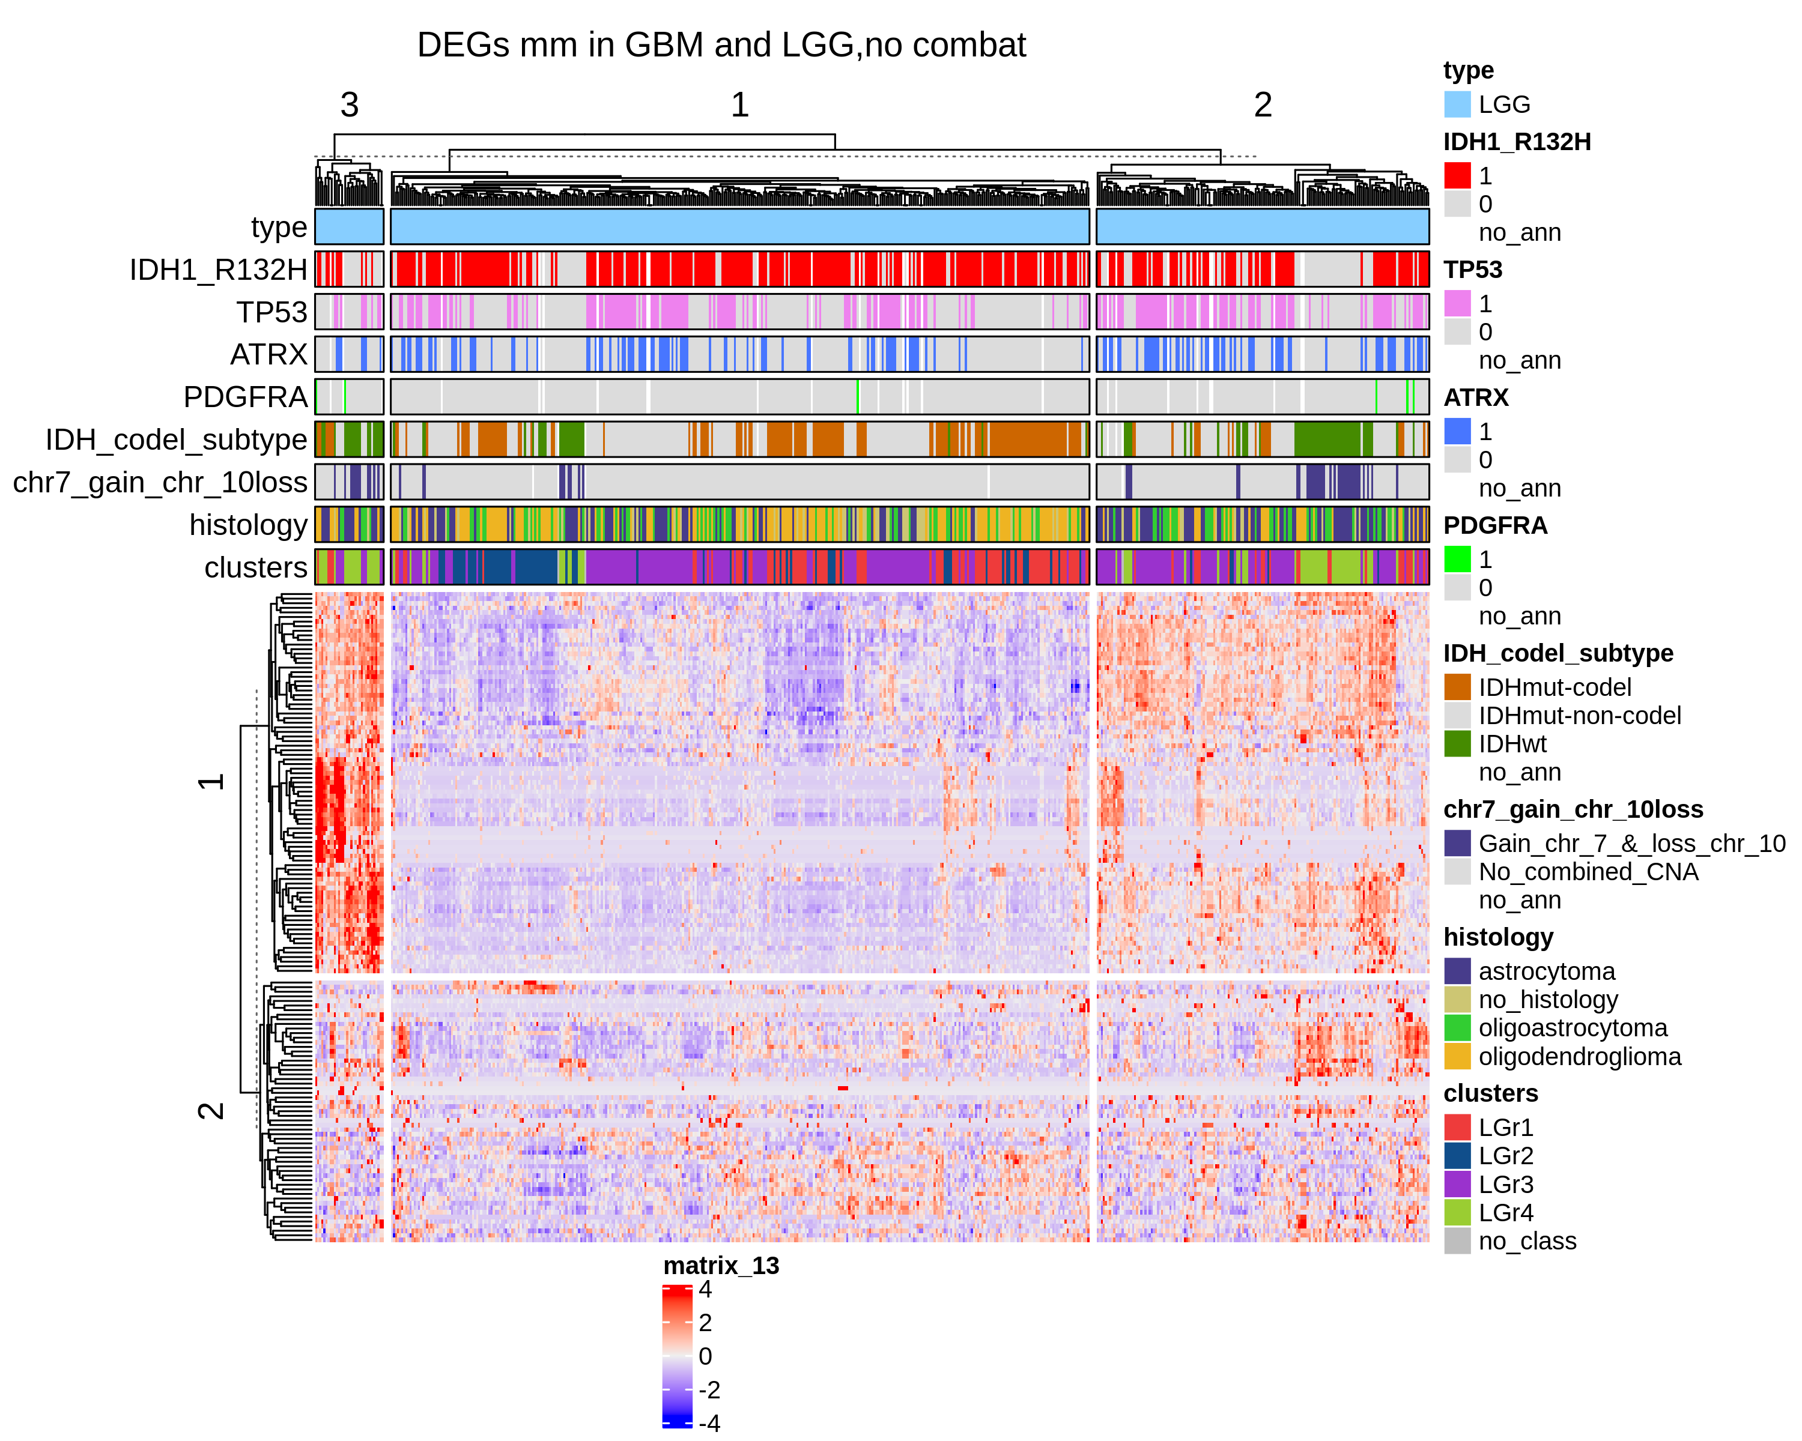
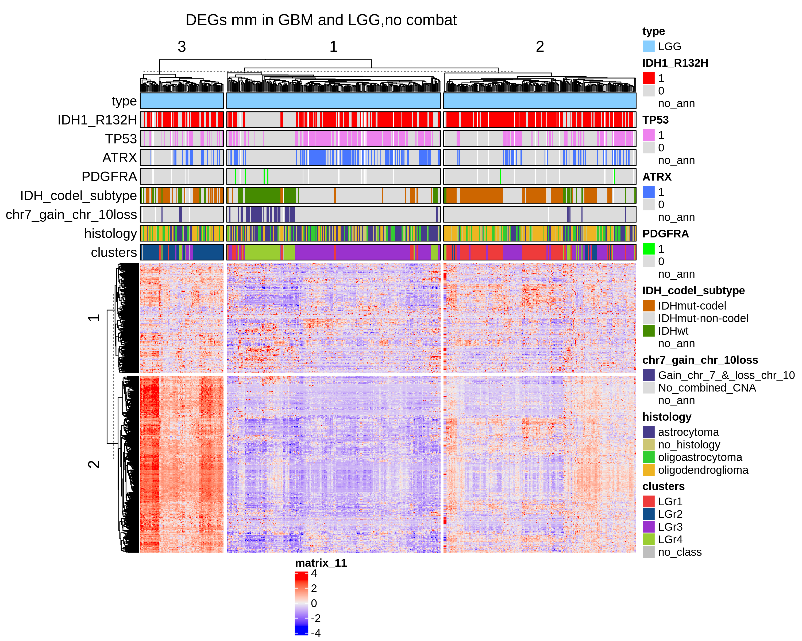
Differentially express genes between C1 vs C2 (q.value 0.01 – 2)
LGG
UP regulated genes
DOWN regulated genes

Slide 10
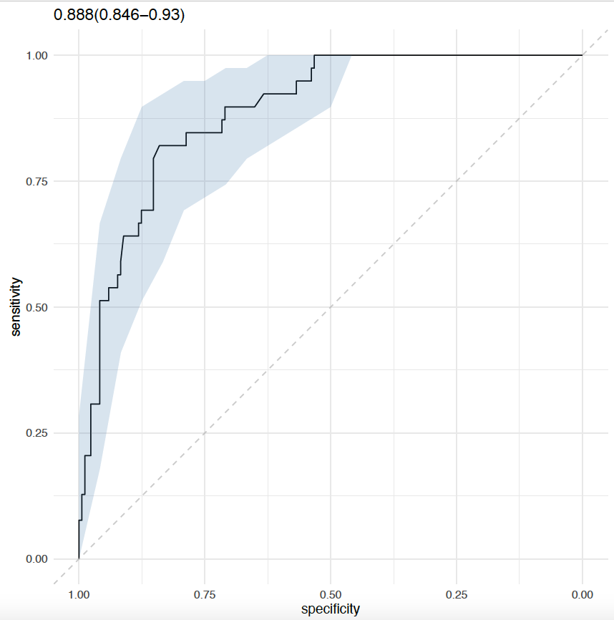
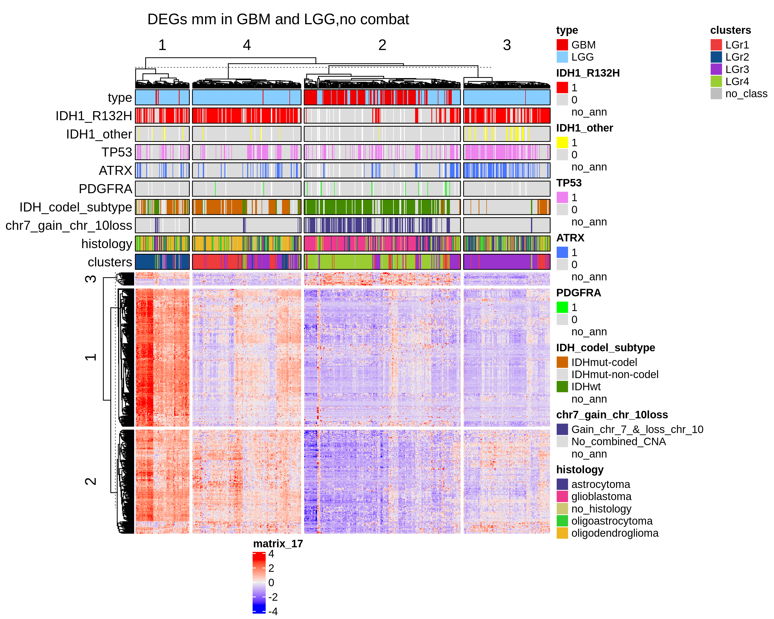
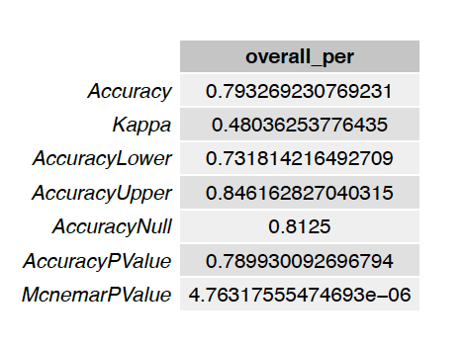
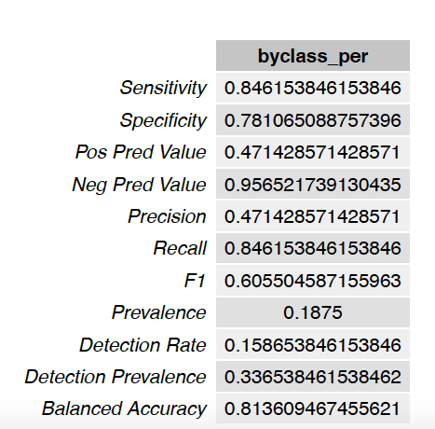
Differentially express genes between C1 vs C2 (q.value 0.01 – 2) + 2 filtering
GBM + LGG
N.Genes = 373

Slide 11
Differentially express genes between C1 vs C2 (q.value 0.01 – 2) + 2 filtering
GBM + LGG
n.iter = 100
size gene sets = 373
From the analysis I have excluded the DEGs

Slide 12
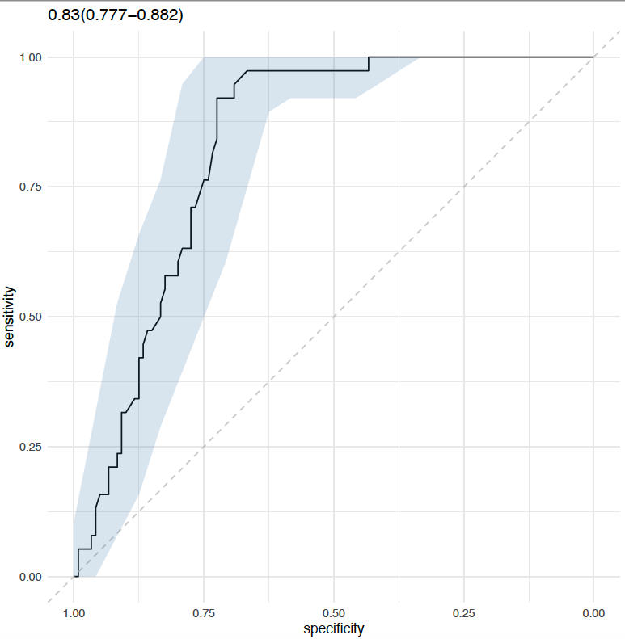
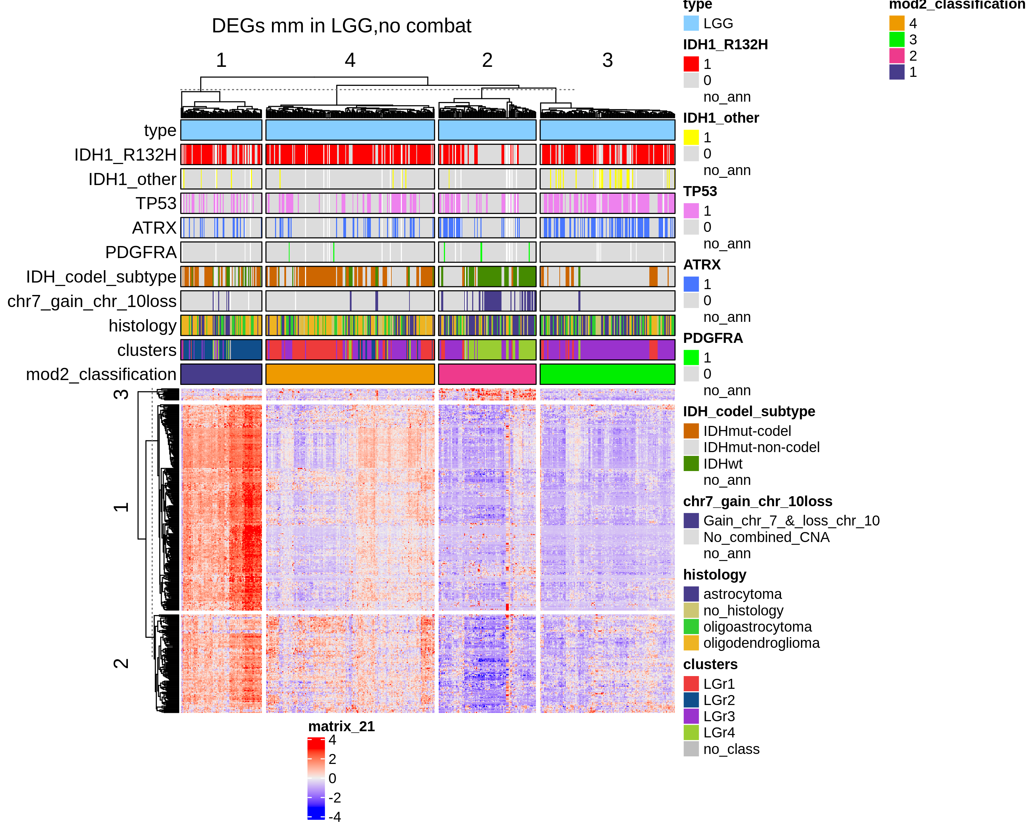
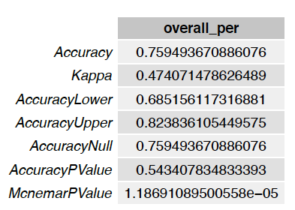
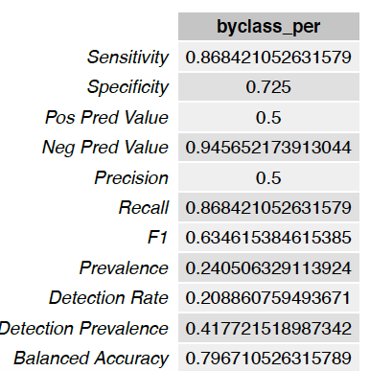
Differentially express genes between C1 vs C2 (q.value 0.01 – 2) + 2 filtering
LGG

Slide 13
Differentially express genes between C1 vs C2 (q.value 0.01 – 2) + 2 filtering
LGG
n.iter = 100
size gene sets = 373
From the analysis I have excluded the DEGs

Slide 14
C1A vs C1B

Slide 15
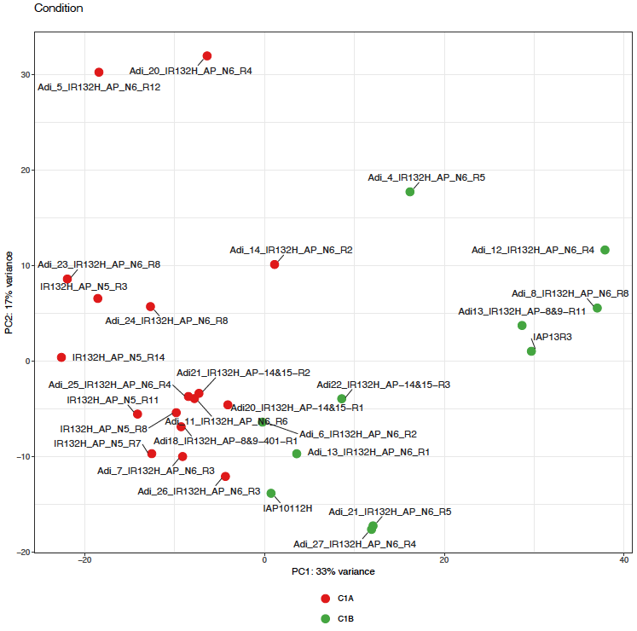

Slide 16
Number of genes DEGs between C1A and C1B
Analysis November 11/11/2020
qval lfc | 0.05 1 | 0.05 2 | 0.05 3 | 0.01 1 | 0.01 2 | 0.01 3 | 0.001 1 | 0.001 2 | 0.001 3 | 1e-04 1 | 1e-04 2 | 1e-04 3
DESeq2_rmv5_Adi18_10_22_CSHS15 | 2215 | 838 | 146 | 1771 | 704 | 112 | 1345 | 585 | 82 | 1049 | 490 | 55
Analysis February 02/04/2021
qval lfc | 0.05 1 | 0.05 2 | 0.05 3 | 0.01 1 | 0.01 2 | 0.01 3 | 0.001 1 | 0.001 2 | 0.001 3 | 1e-04 1 | 1e-04 2 | 1e-04 3
adi_february_2021 | 1854 | 384 | 3 | 1662 | 384 | 3 | 1261 | 382 | 3 | 920 | 329 | 3
q.value 0.05 and lfc 1
q.value 0.05 and lfc 2
(Ceccarelli size = 2274)
(Ceccarelli size = 2274)
7 %
1 %

Slide 17
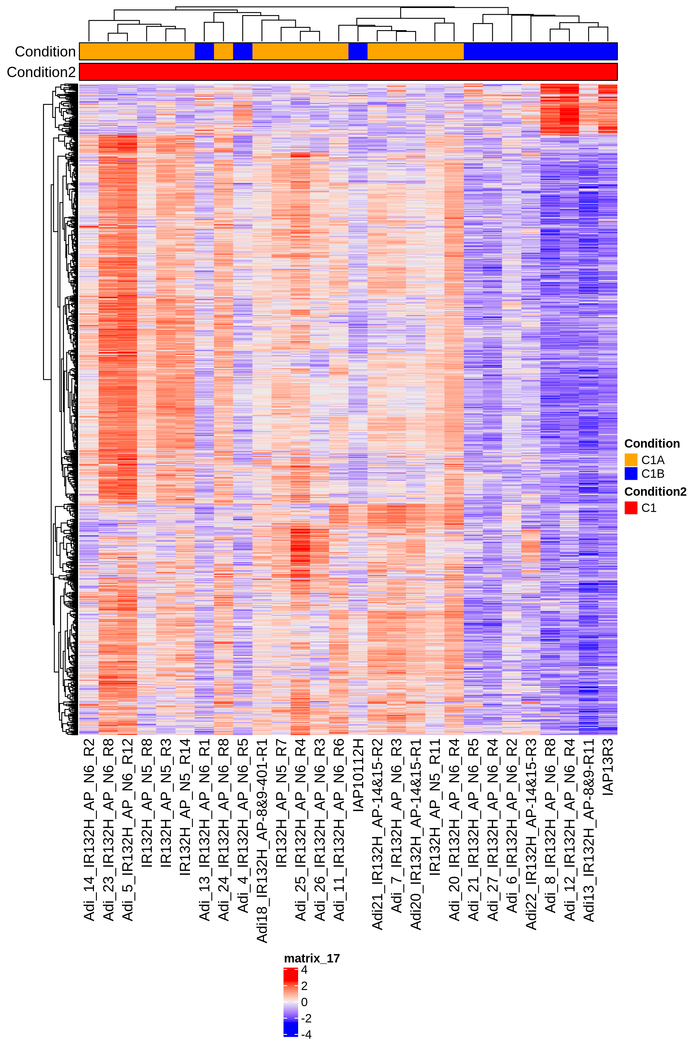
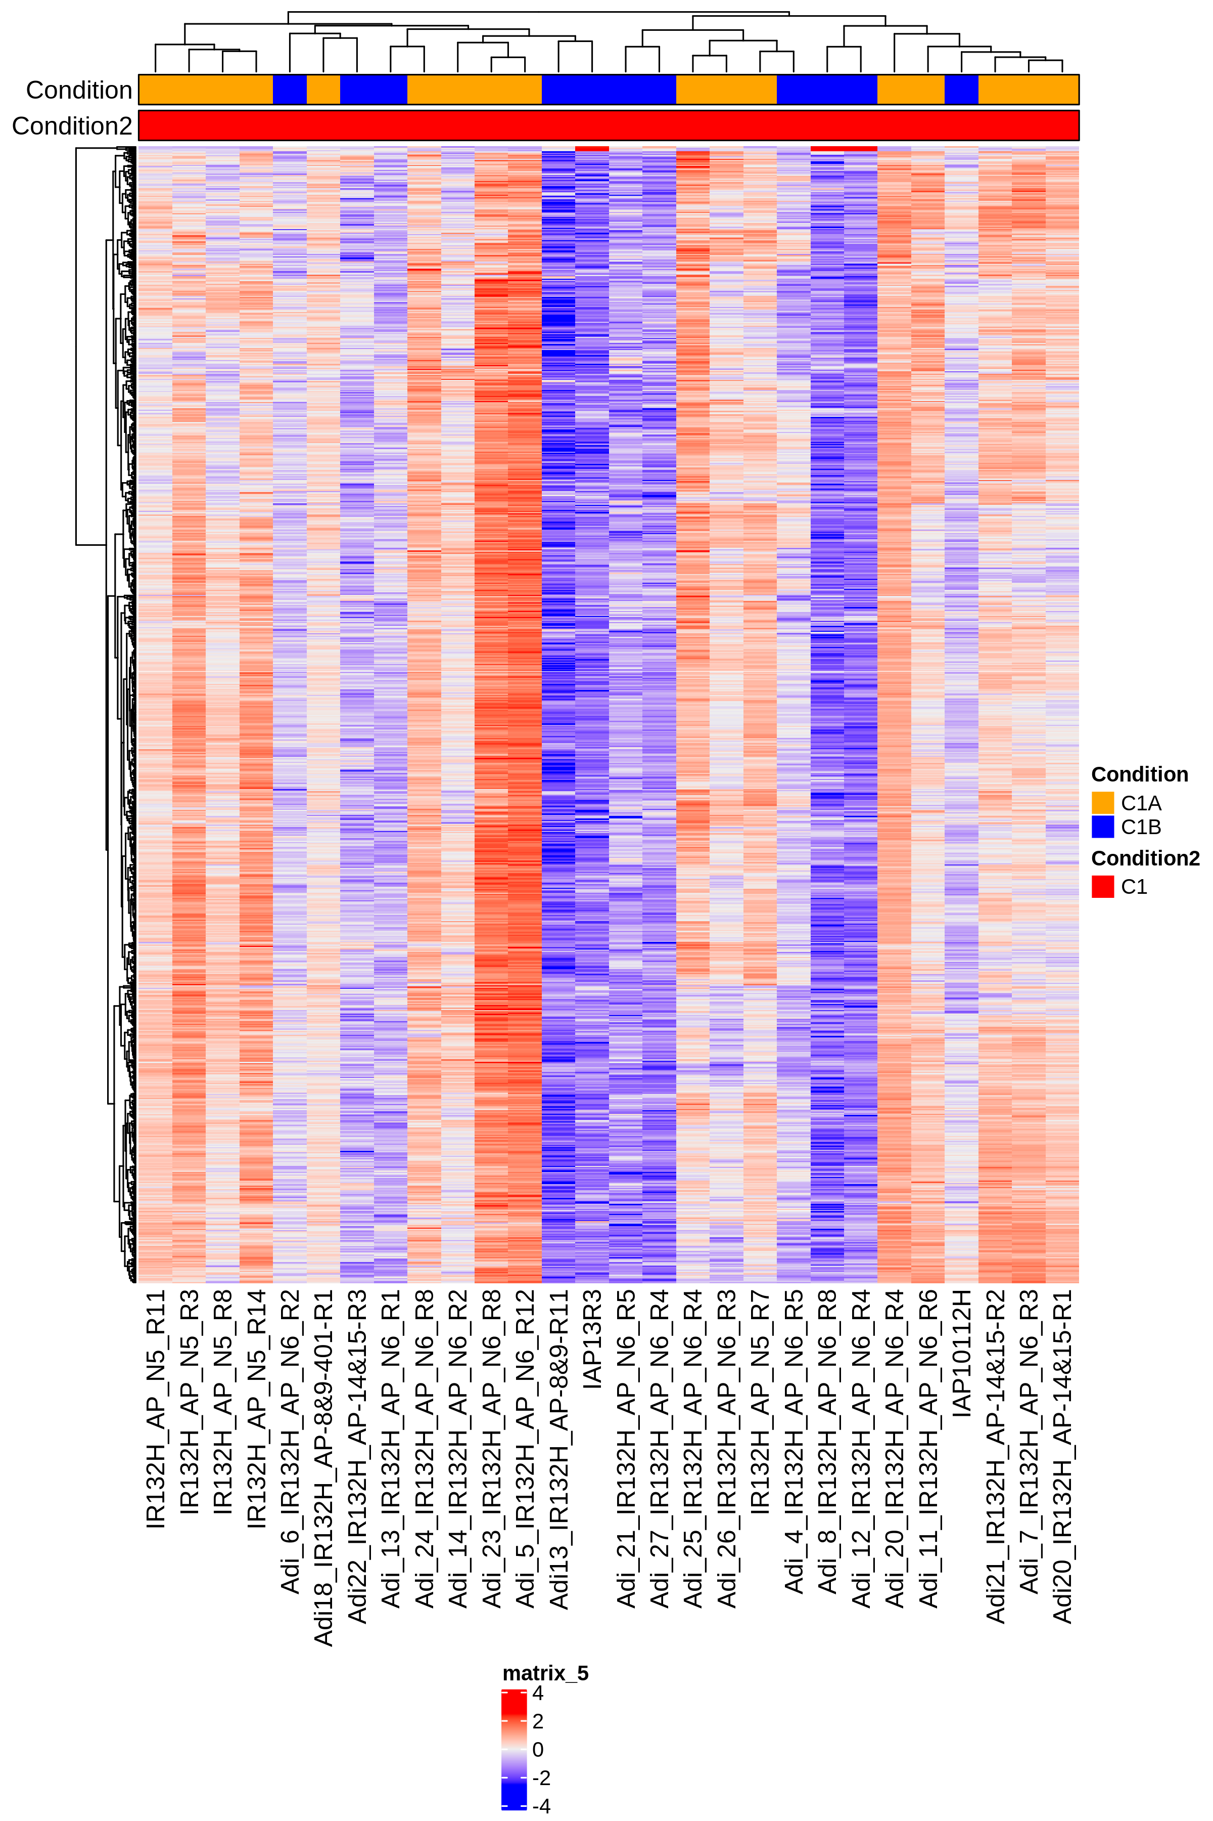
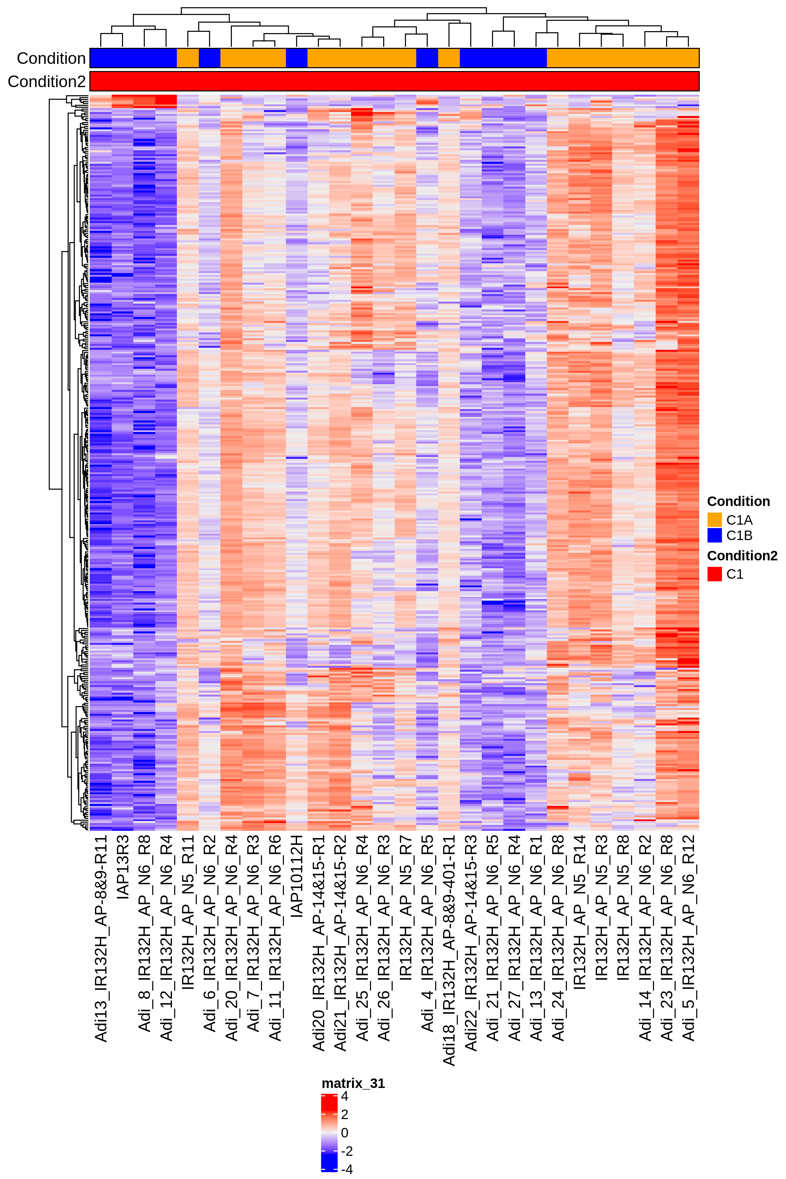
q.value 0.05 and lfc 1
q.value 0.0001 and lfc 1
q.value 0.05 and lfc 2

Slide 18
q.value 0.05 and lfc 1

Slide 19
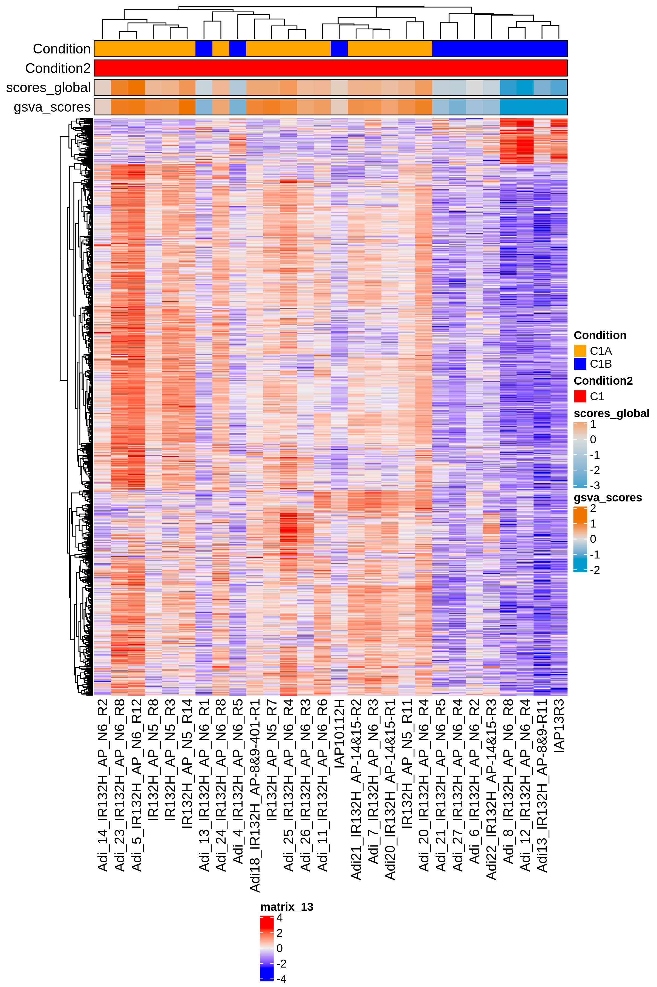
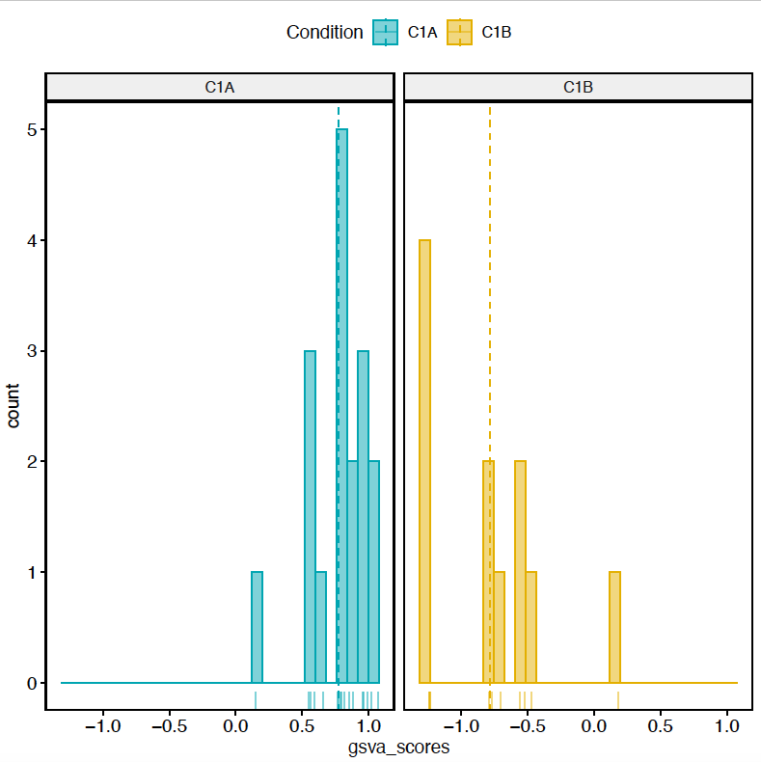
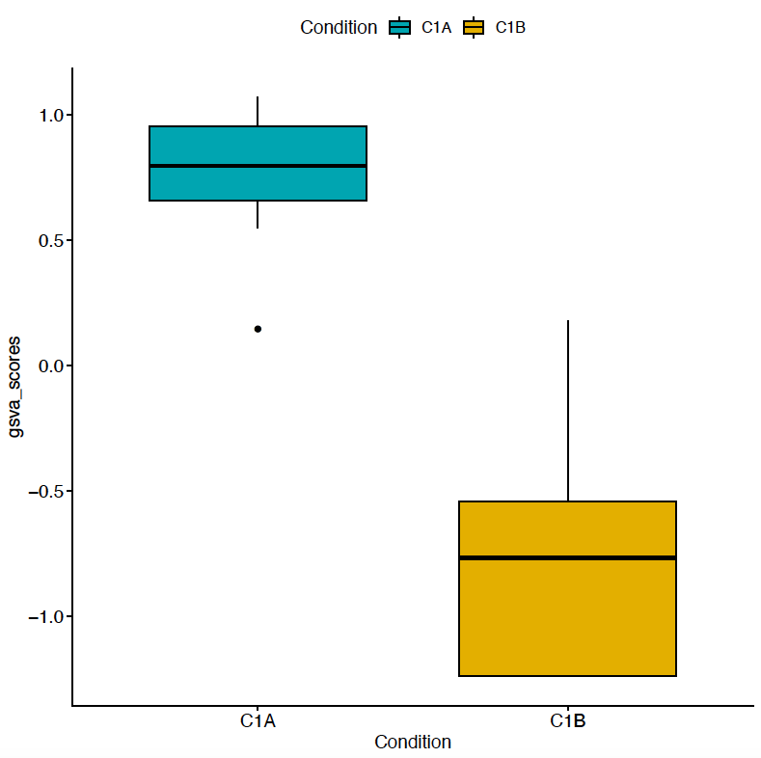
n. genes = 1854

Slide 20
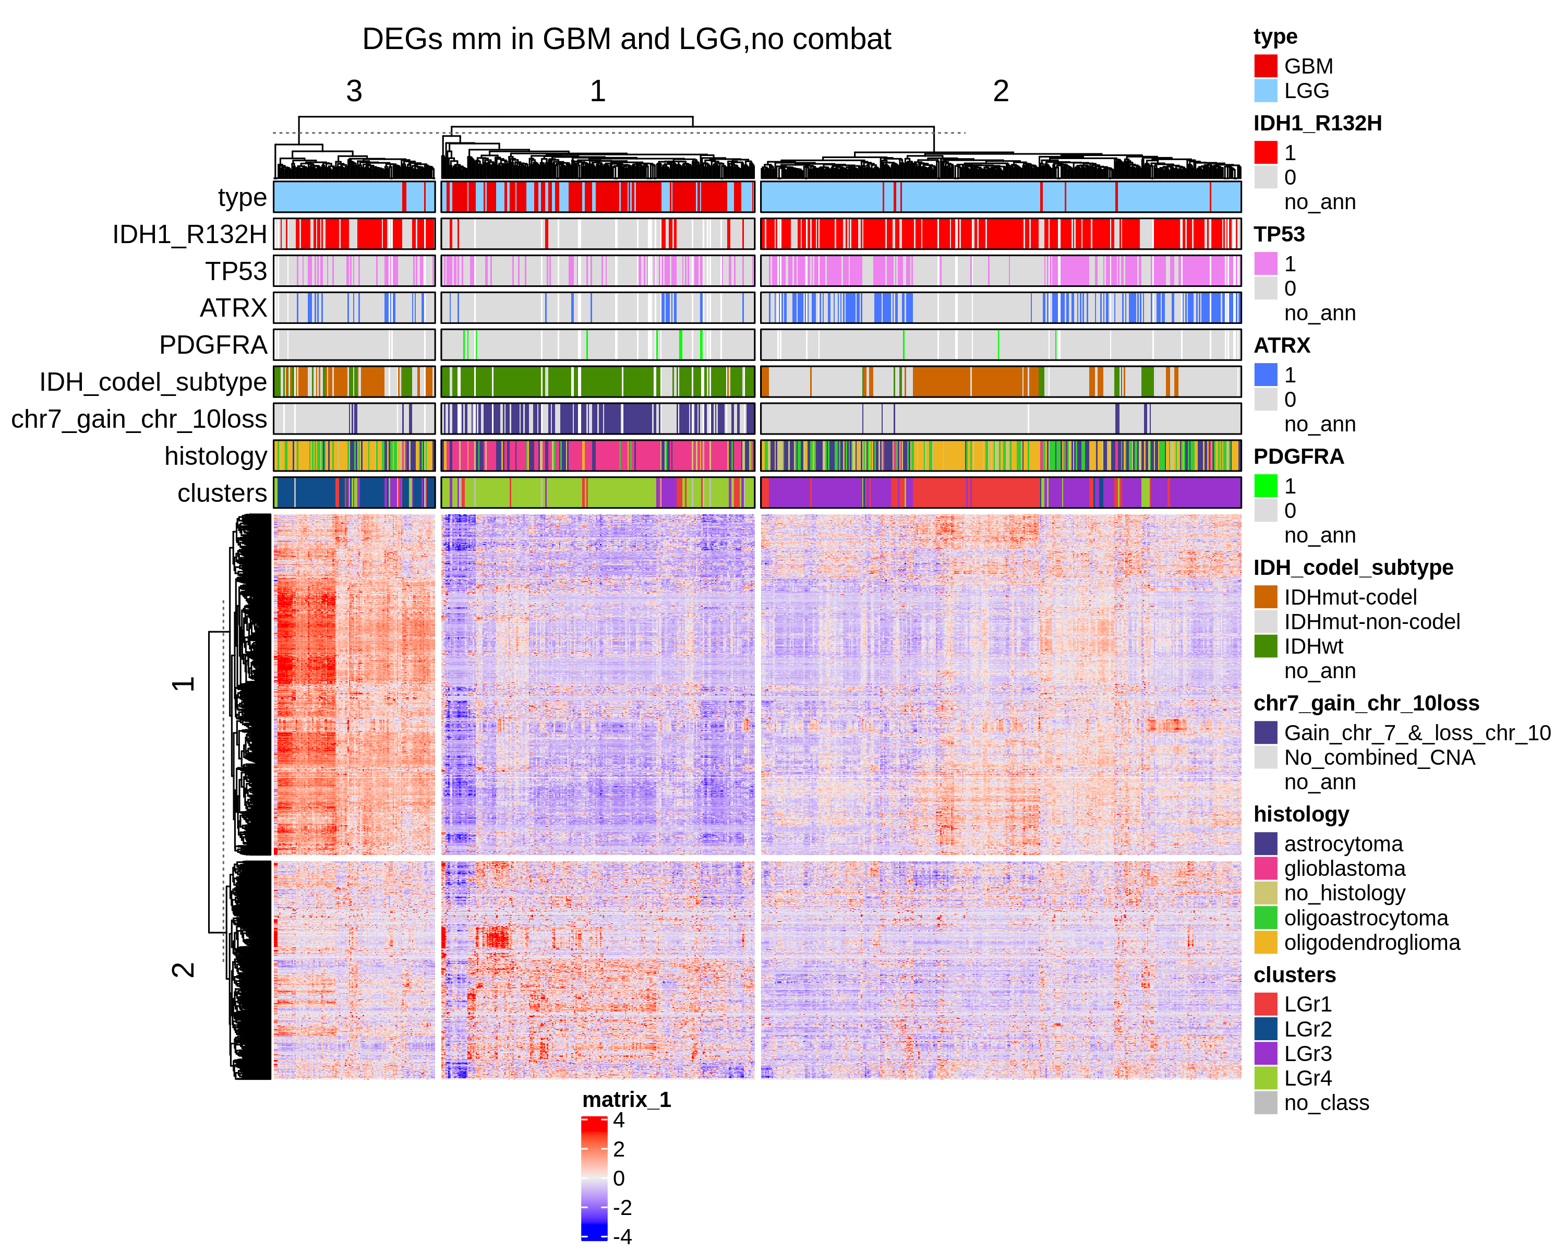
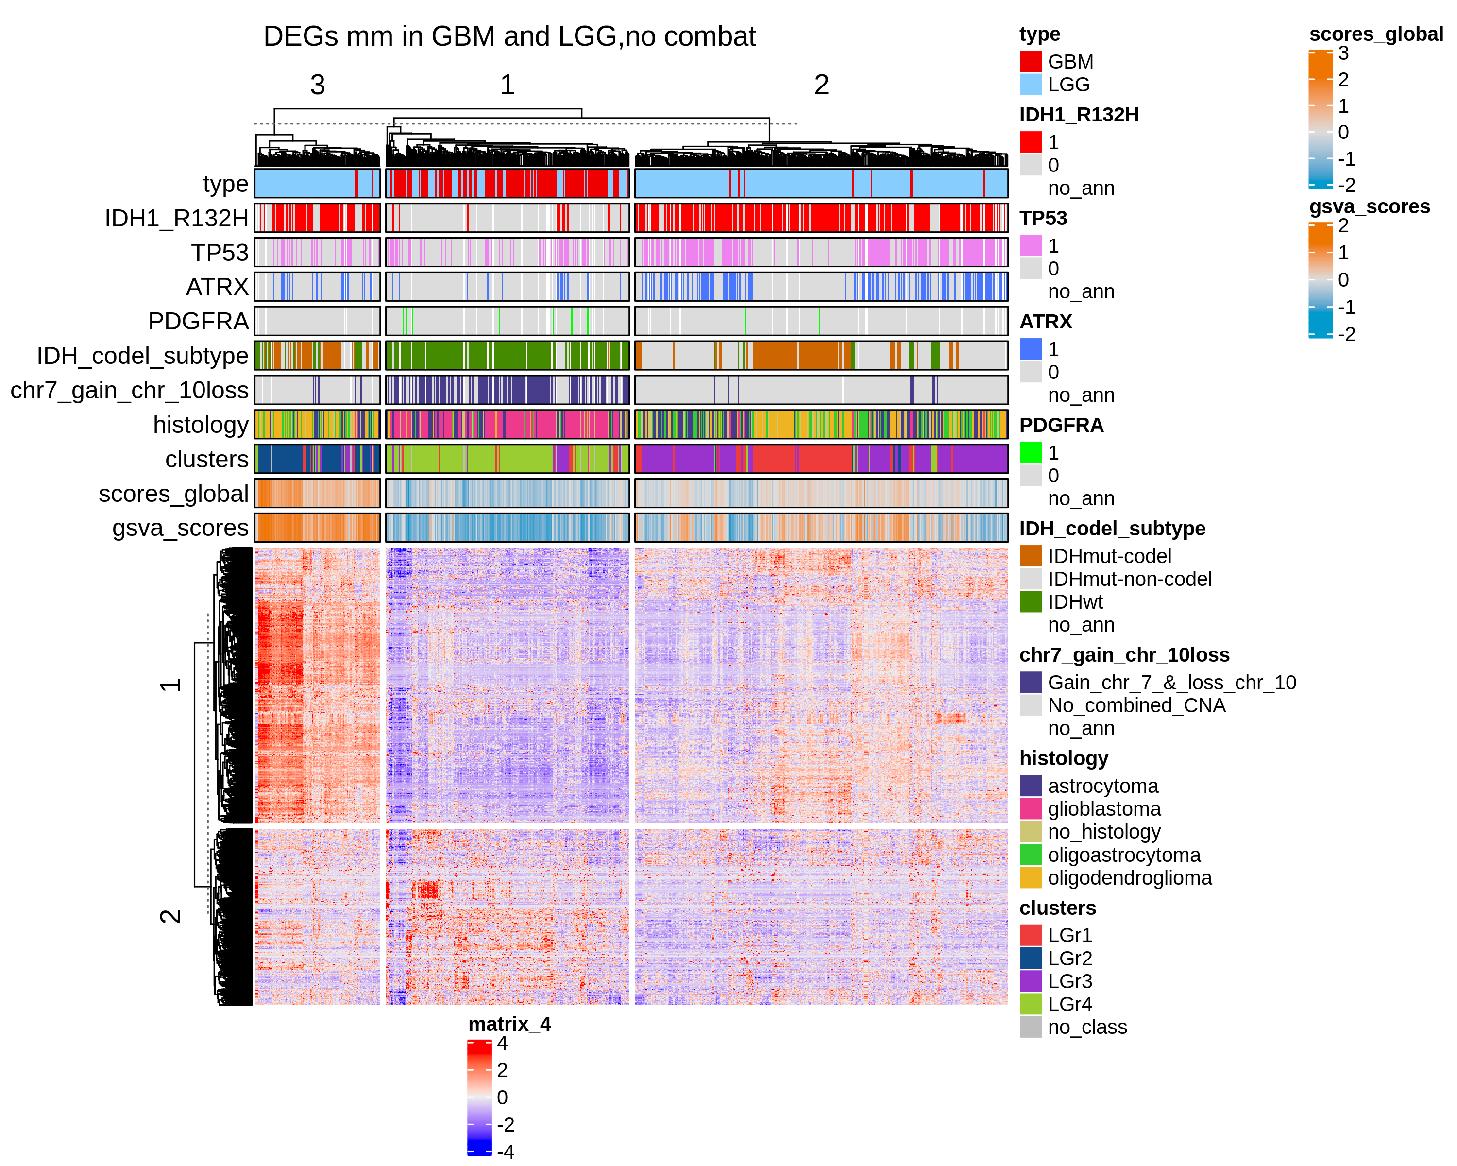
q.value 0.05 and lfc 1
n. genes = 1556

Slide 21
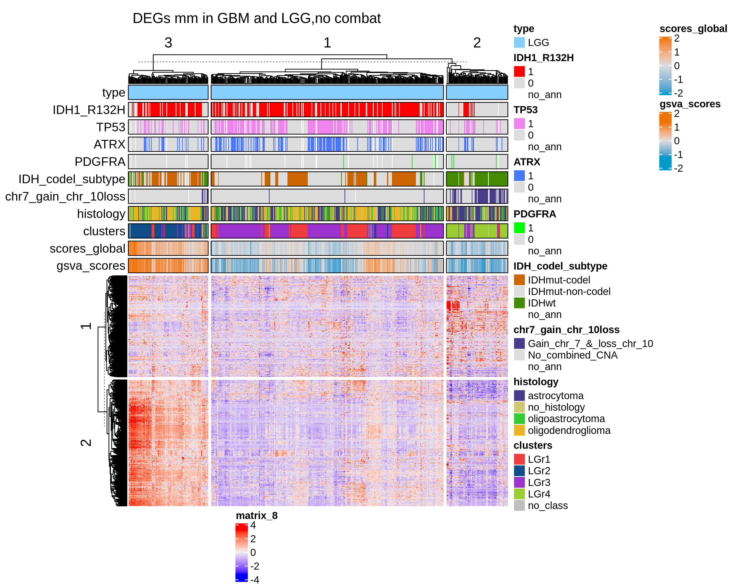
LGG q.value 0.05 and lfc 1

Slide 22
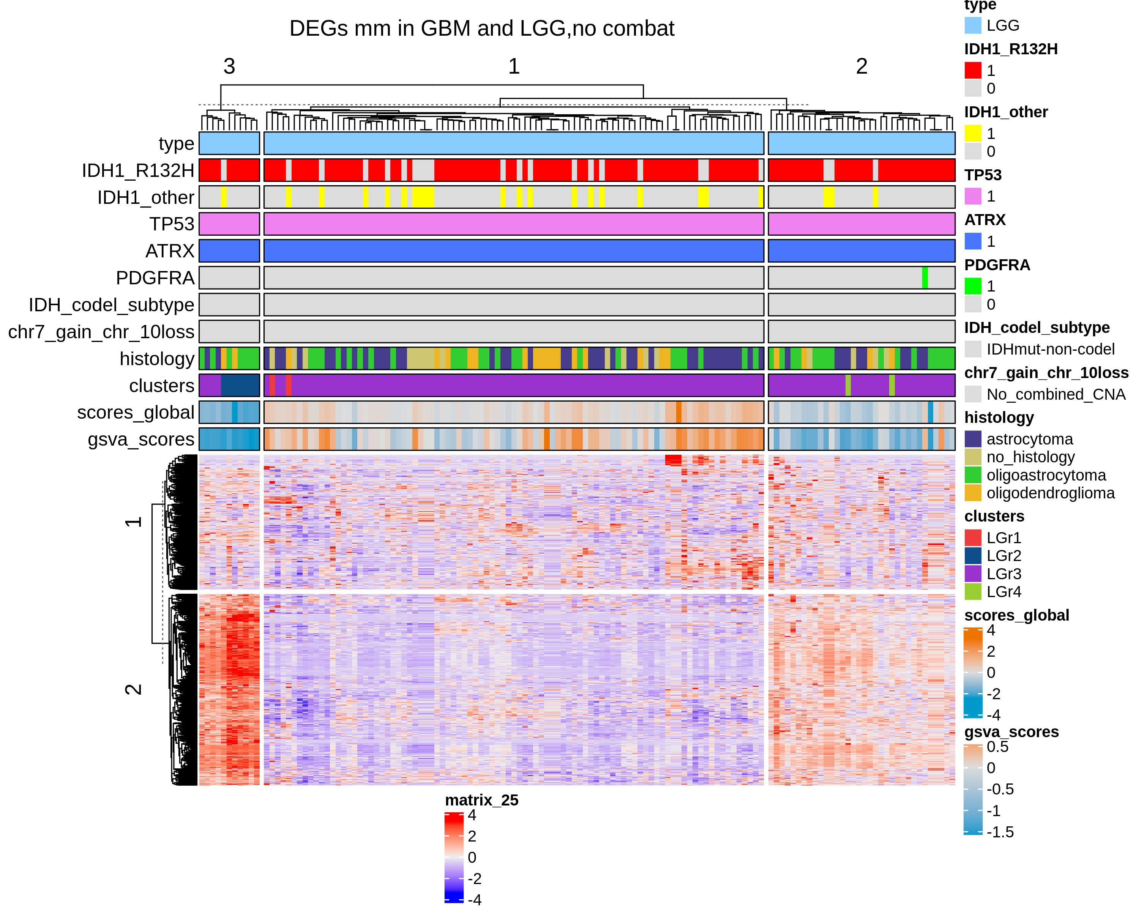
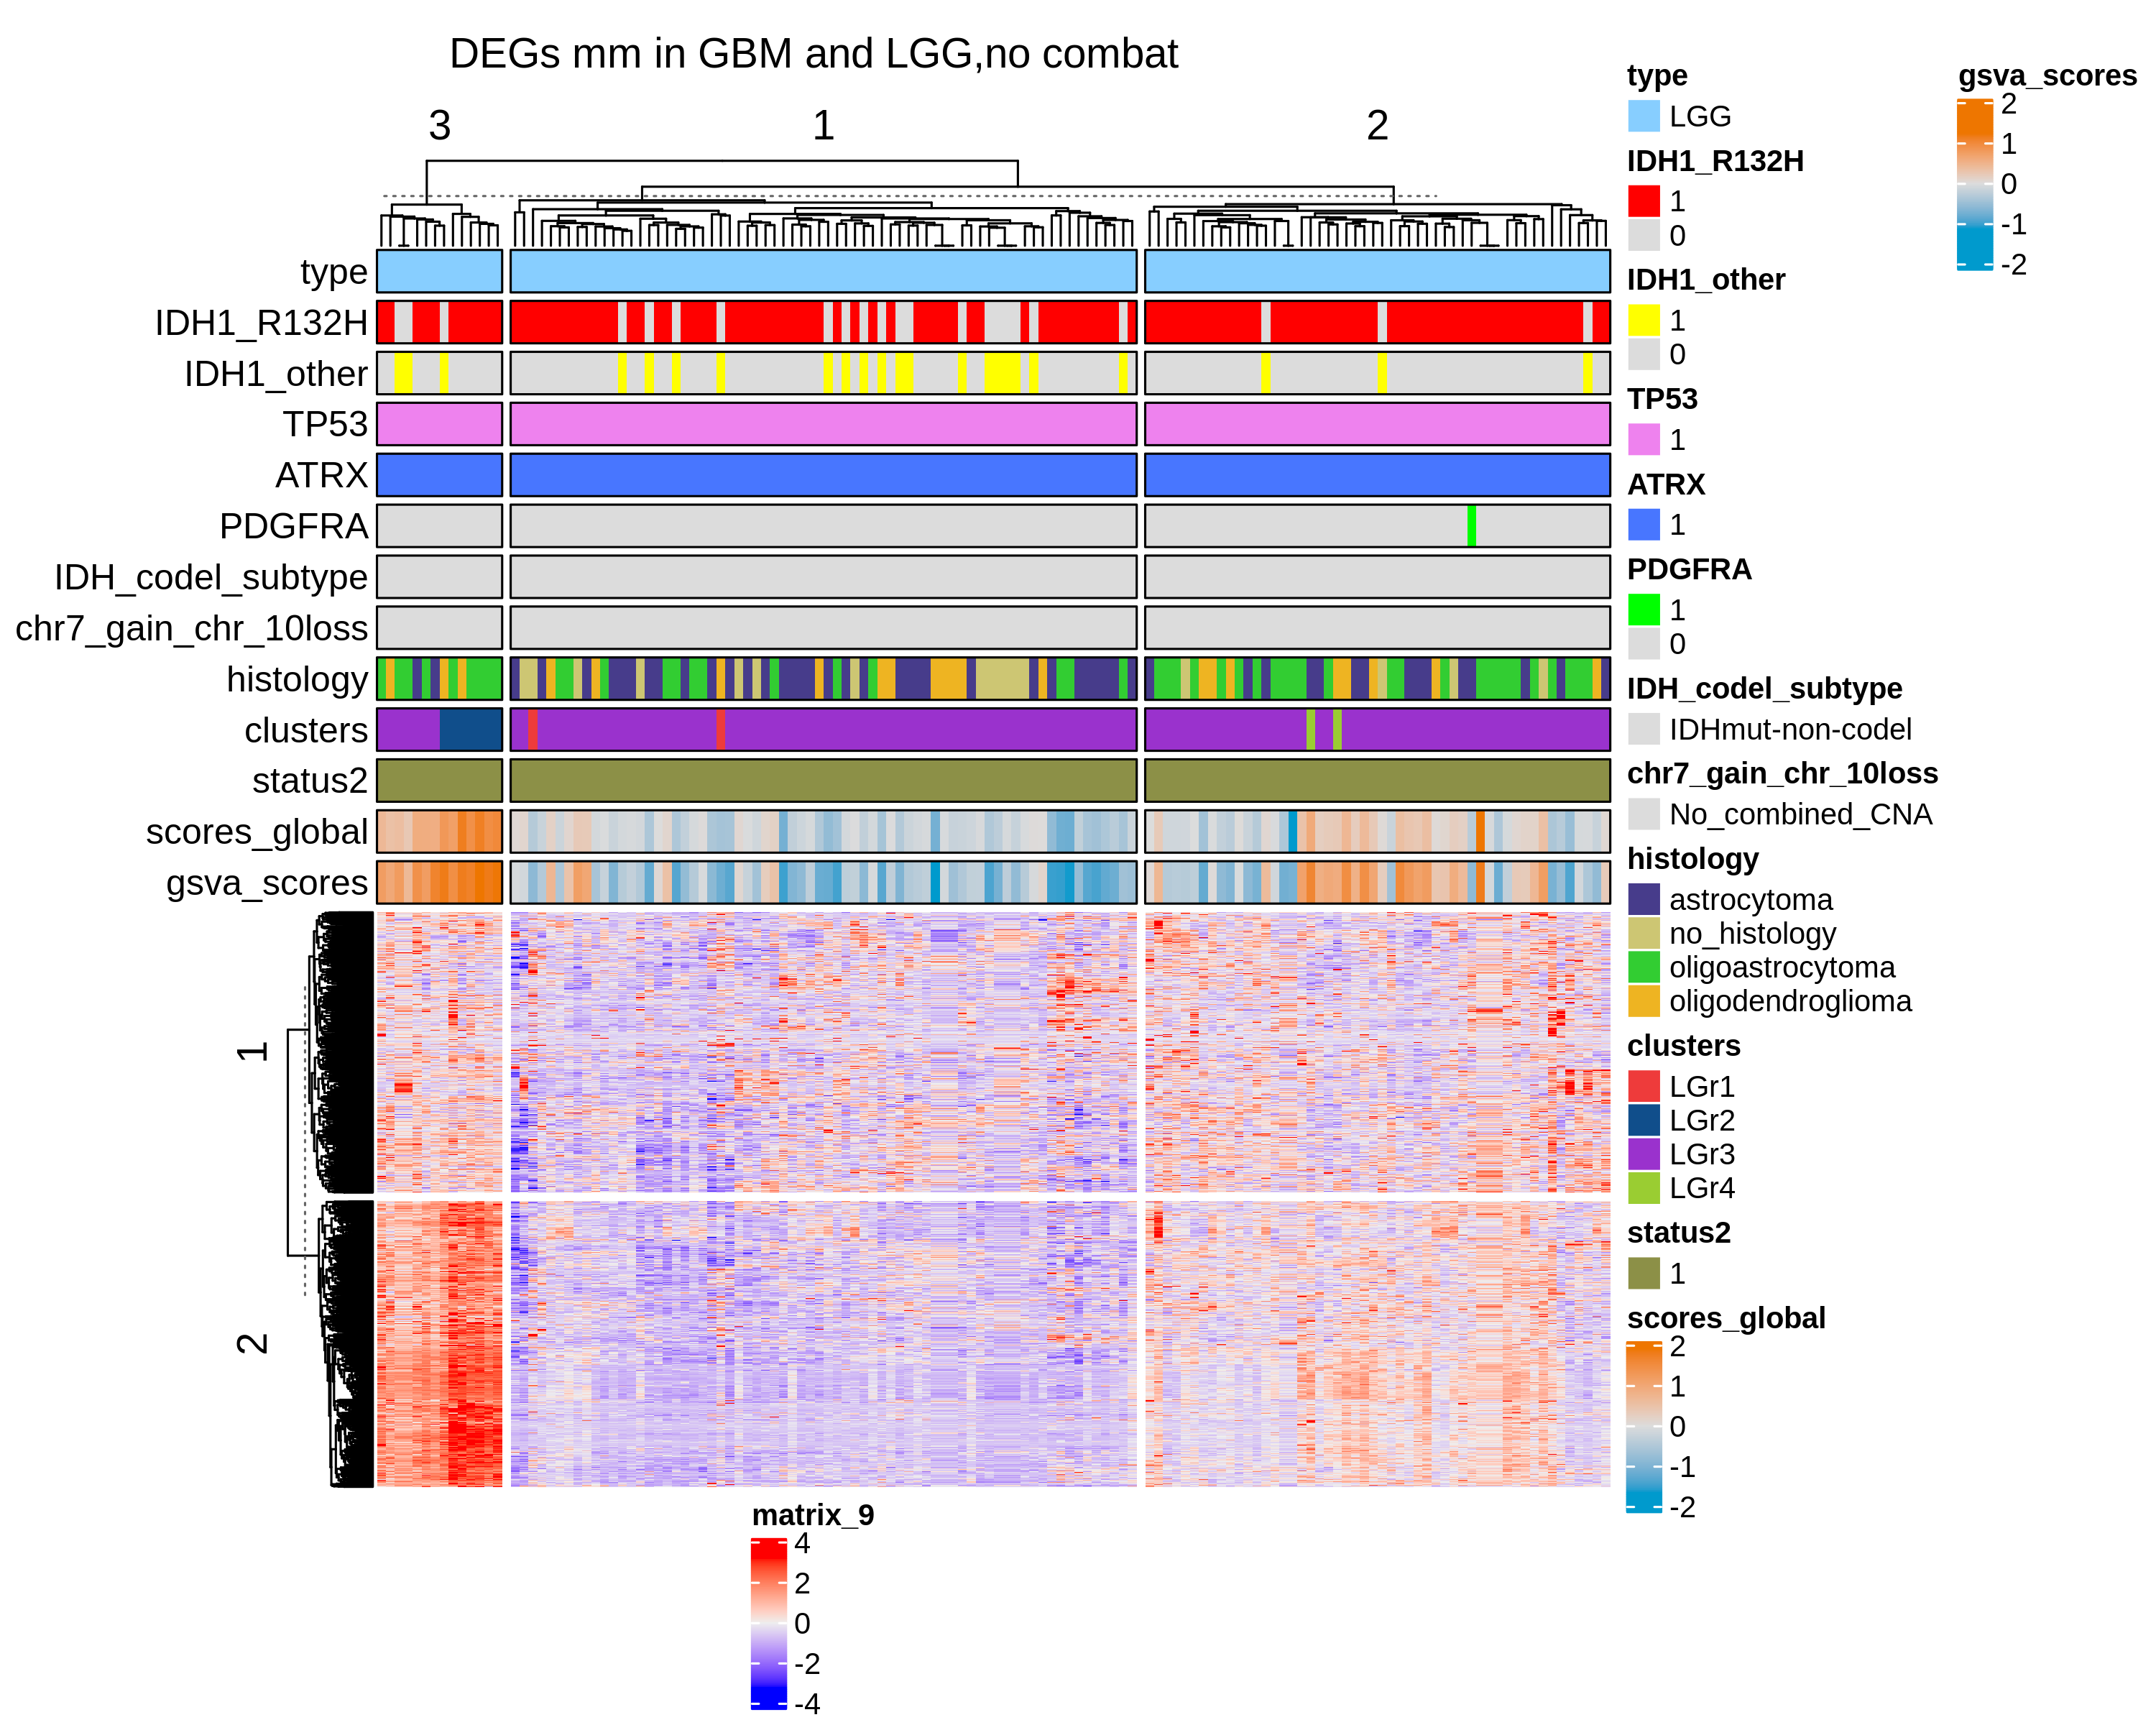
LGG IDH+ ATRX + TP53 q.value 0.05 and lfc 1
May 2021

Slide 23
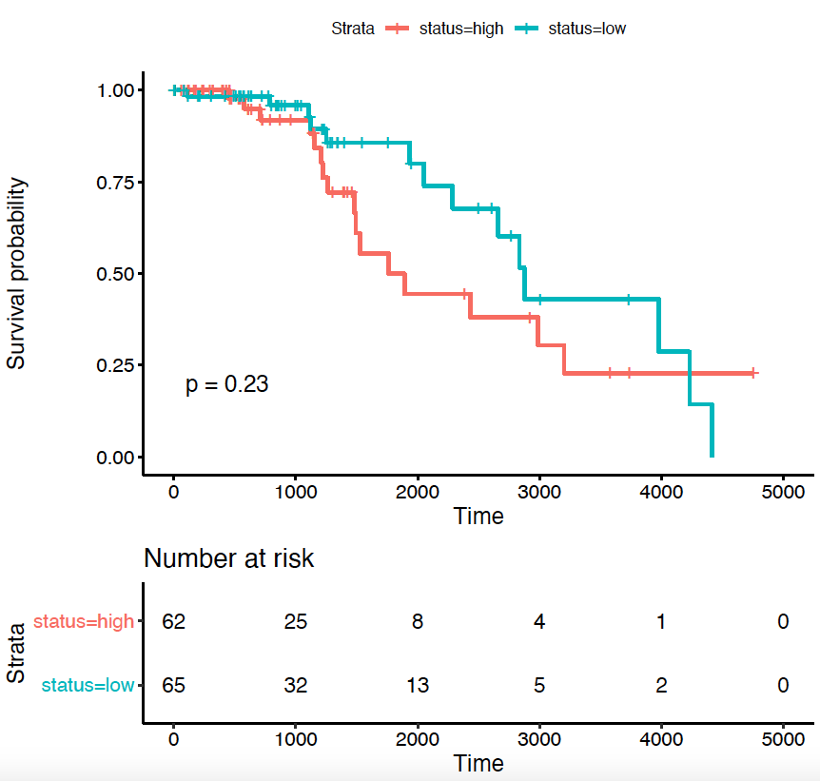
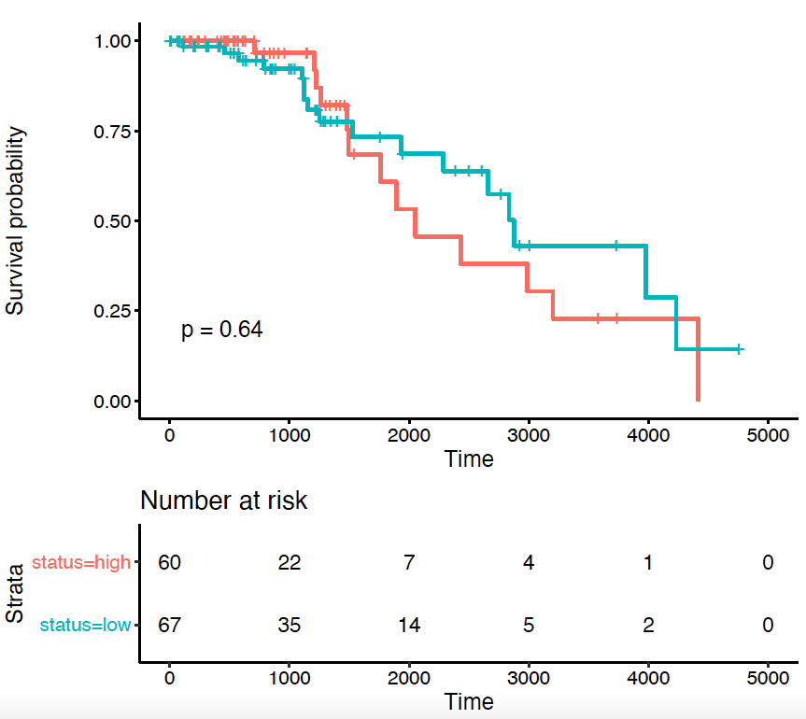
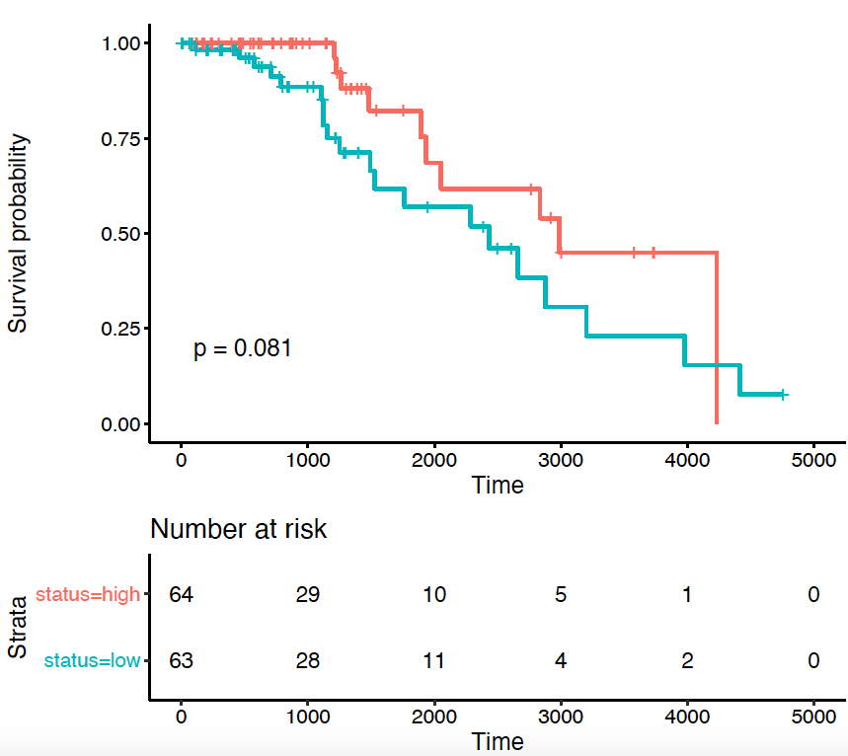
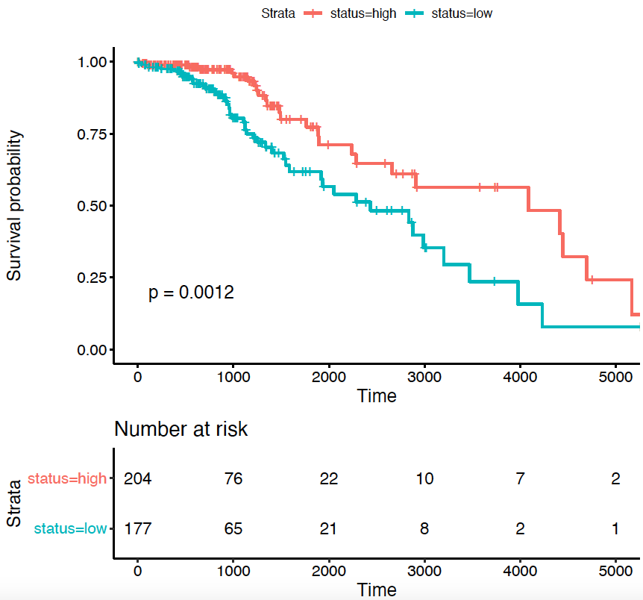
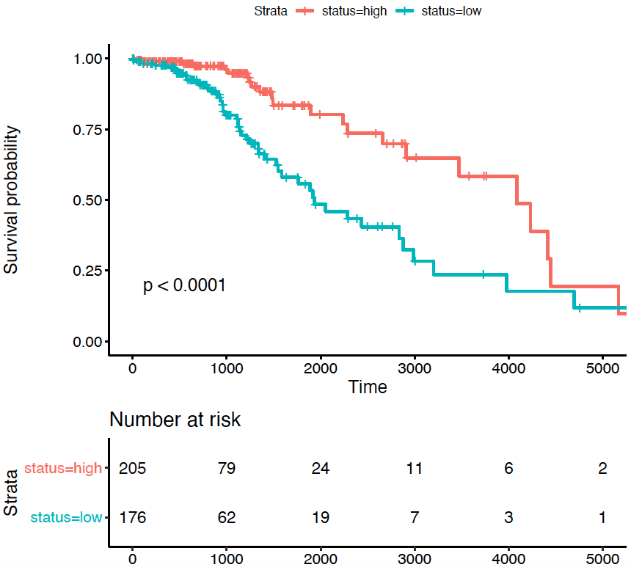
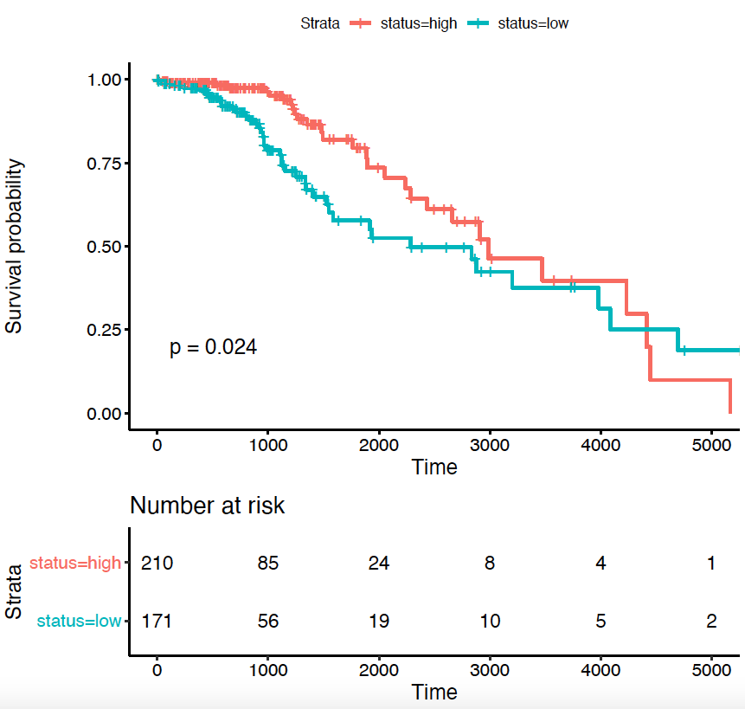
Coxph analysis using the genes DEGs q.value 0.05 and lfc 1 cut.off = 0
0.05
0.01
0.001
UP: 174
Down: 17
UP: 68
Down: 4
LGG
IDH1 + TP53 + ATRX
LGG
IDH1

Slide 24
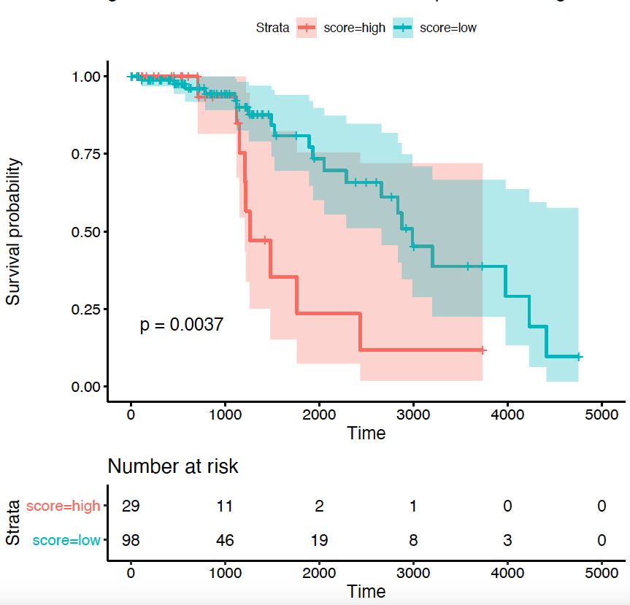
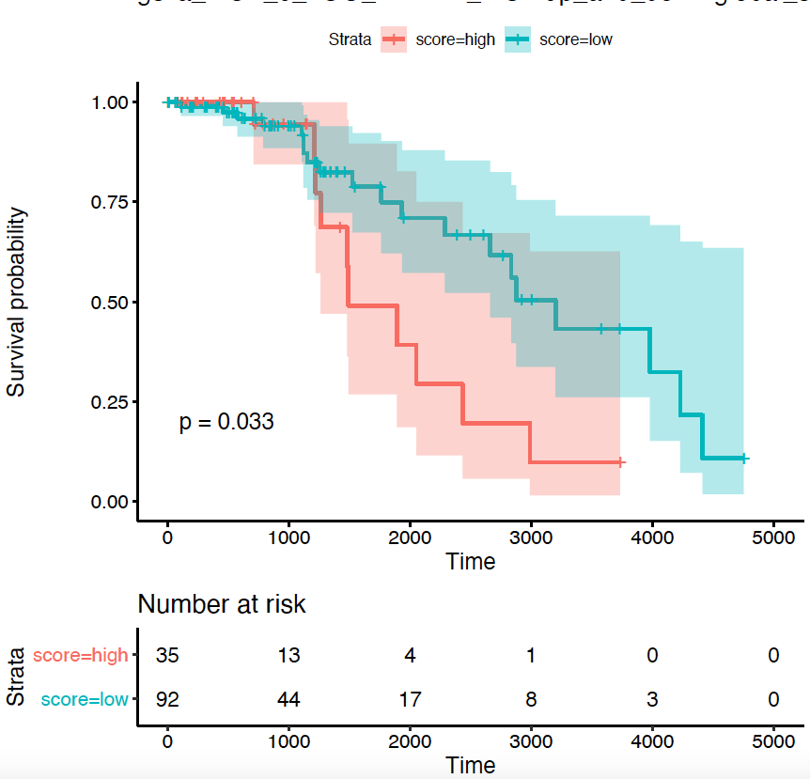
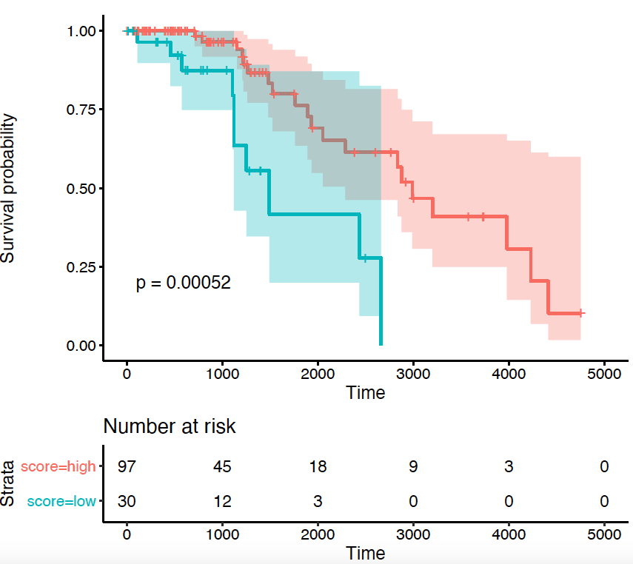
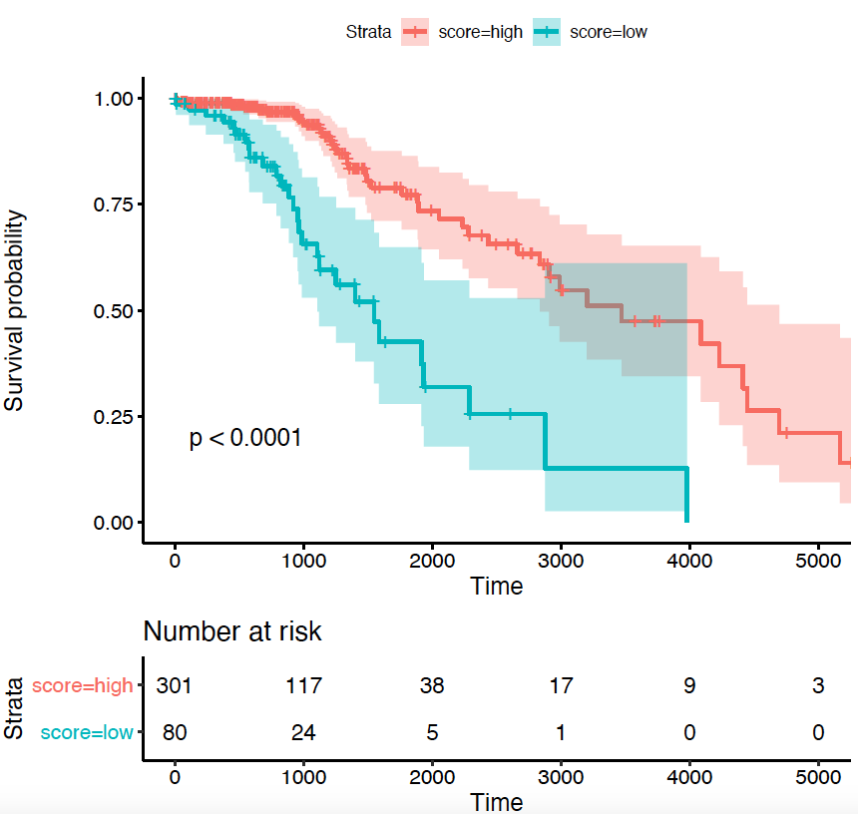
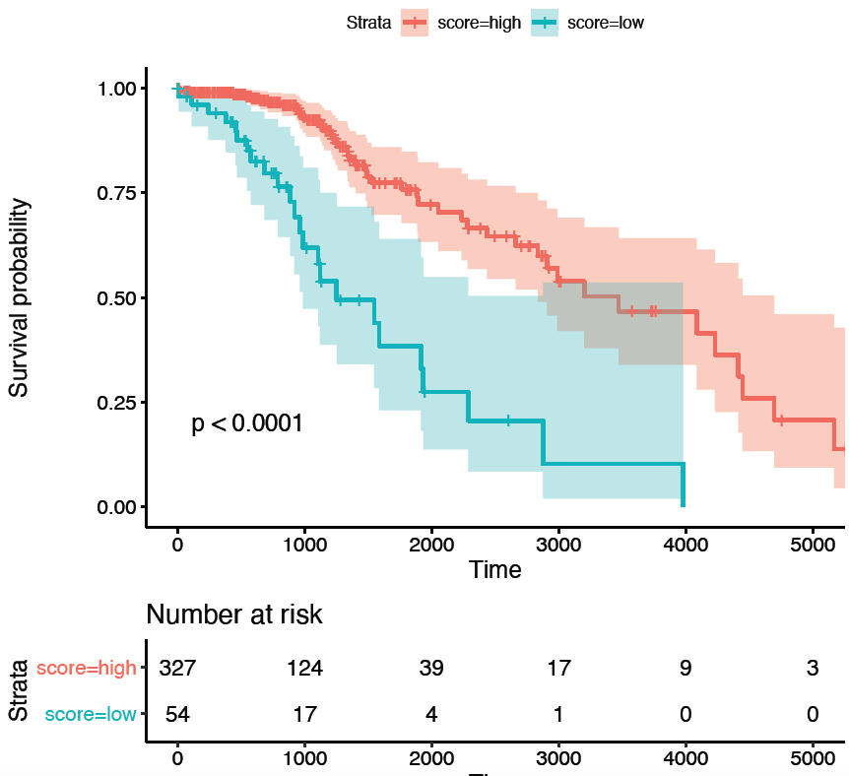
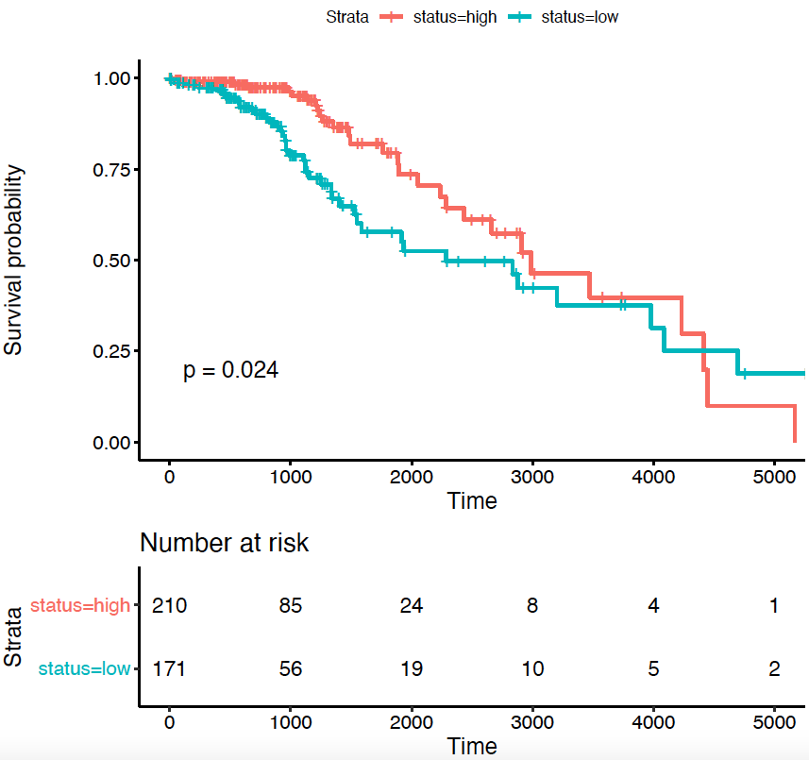
Coxph analysis using the genes DEGs q.value 0.05 and lfc 1
(automatic thr)
0.05
0.01
0.001
UP: 174
Down: 17
C.O. = 0.4
UP: 68
Down: 4
C.O. = 0.35
LGG
IDH1 + TP53 + ATRX
LGG
IDH1

Slide 25
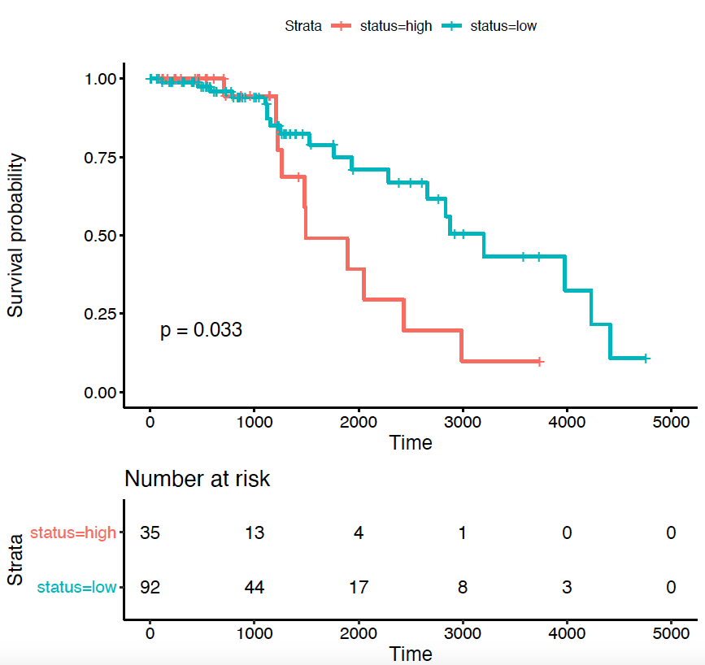
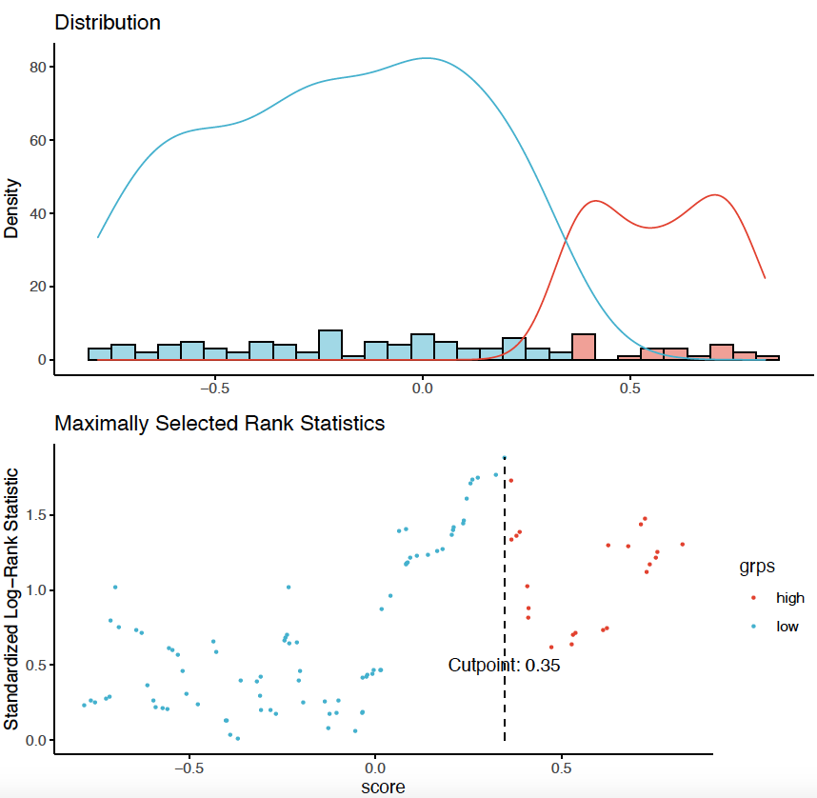
Coxph analysis using the genes DEGs q.value 0.05 and lfc 1 cut.off = 0.4
0.05
Solution 1
q.value = 0.05
LFC = 1
C.O. = 0.35
UP: 68
Down: 4
C.O. = 0.35
LGG
IDH1 + TP53 + ATRX

Slide 26
CompC1AvsC1B
q.value 0.05 and lfc 2

Slide 27
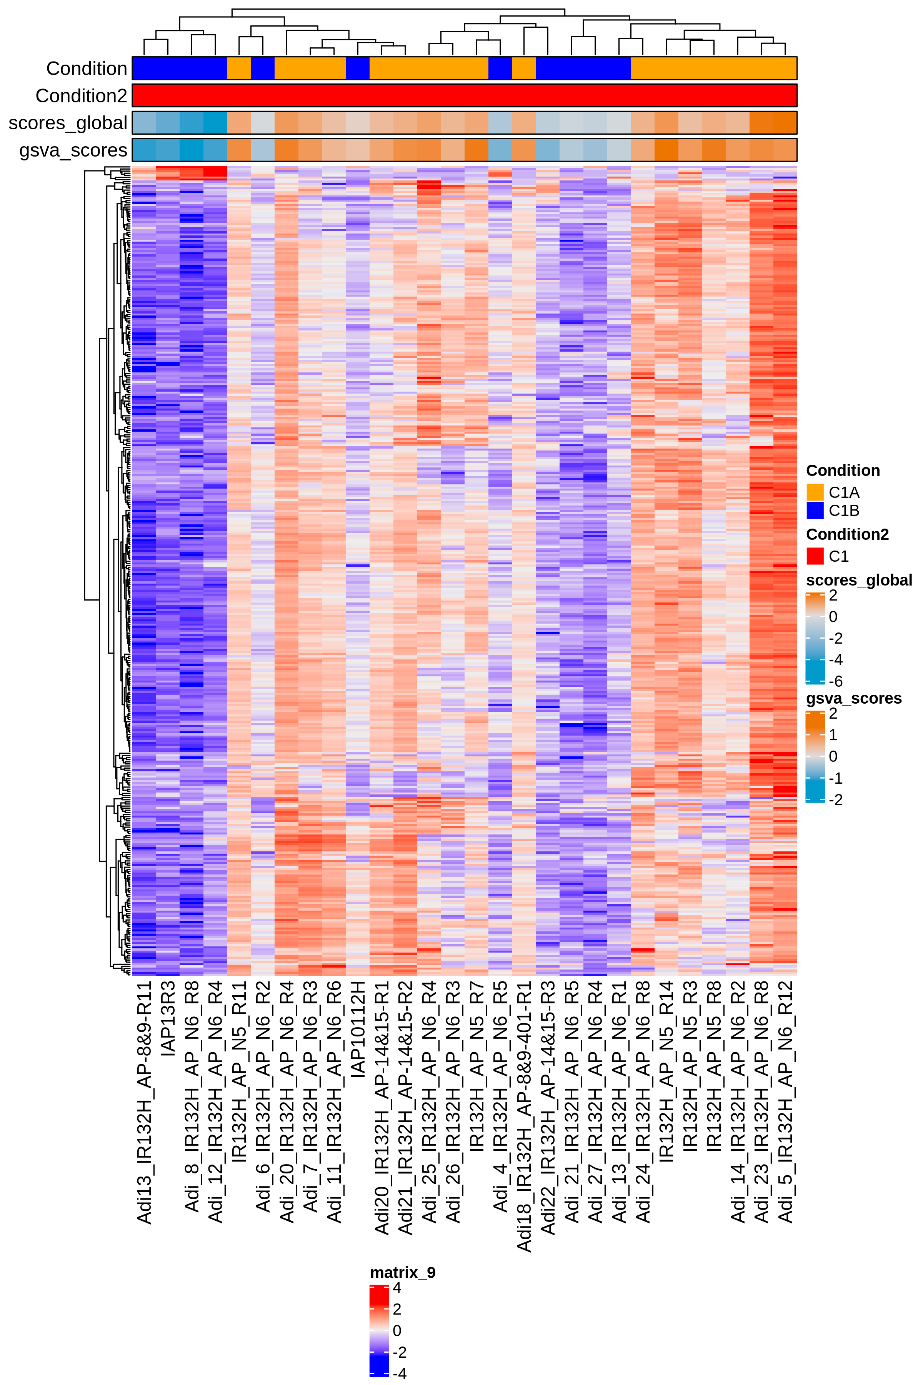
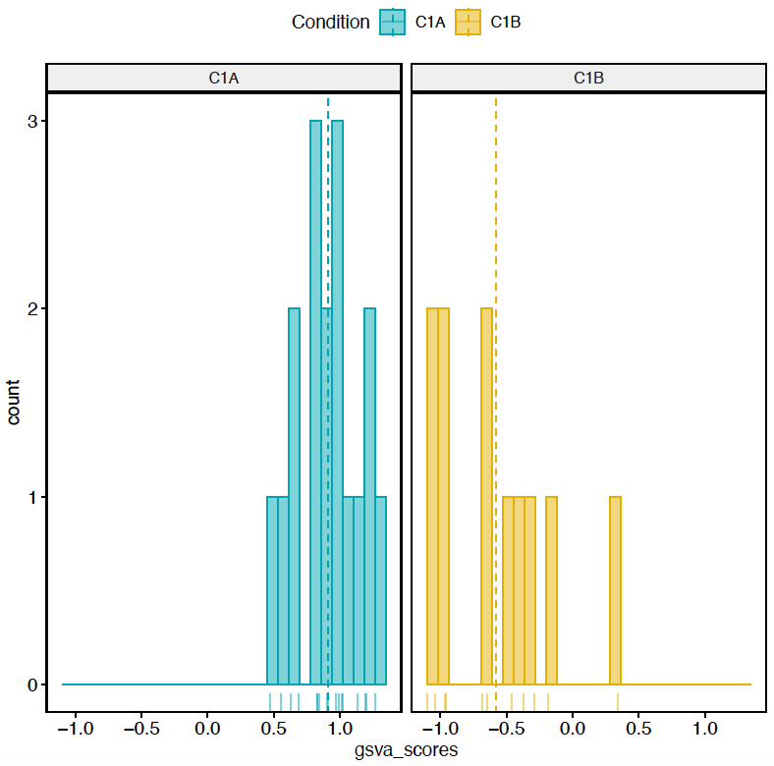

n. genes = 384

Slide 28


CompC1AvsC1B q.value 0.05 and lfc 2
n. genes = 337

Slide 29

LGG q.value 0.05 and lfc 2

Slide 30

CompC1AvsC1B LGG IDH+ ATRX + TP53 q.value 0.05 and lfc 2

Slide 31






CompC1AvsC1B
Coxph analysis using the genes DEGs q.value 0.05 and lfc 2 cut.off = 0
0.05
0.01
0.001
UP: 45
Down: 0
UP: 17
Down: 0
LGG
IDH1 + TP53 + ATRX
LGG
IDH1

Slide 32






CompC1AvsC1B Coxph analysis using the genes DEGs q.value 0.05 and lfc 2
(automatic thr)
0.05
0.01
0.001
UP:
Down:
C.O. = 0.17
UP:
Down:
C.O. = 0.19
UP:
Down:
C.O. = 0.65
LGG
IDH1 + TP53 + ATRX
LGG
IDH1

Slide 33
CompC1AvsC1B
Coxph analysis using the genes DEGs q.value 0.05 and lfc 2 cut.off = 0
0.05
Solution 2 (***)
q.value = 0.05
LFC = 2
C.O. = 0
LGG
IDH1 + TP53 + ATRX

Slide 34
TCGA-R8-A6YH
clin.lgg <- GDCquery_clinic("TCGA-LGG", "clinical")
features_to_select<-c("submitter_id","days_to_death","days_to_last_follow_up","vital_status")
clin.lgg2<-clin.lgg[,colnames(clin.lgg)%in%features_to_select]
clin.lgg[grep(clin.lgg$ submitter_id,pattern="TCGA-R8-A6YH"),]
No sample

